Slide 1

Gold Mines in Egypt
Presented by :
Marwan Adel : 16102096
Yassen Adel : 15102520
Mohamed Reda:16102032

Slide 2
Agenda:
We will explain our work in ArcGIS Software.
We will locate Gold mines in Egypt and explain each feature we use.
We will insert screenshots from our project showing our work as clear as possible.

Slide 3
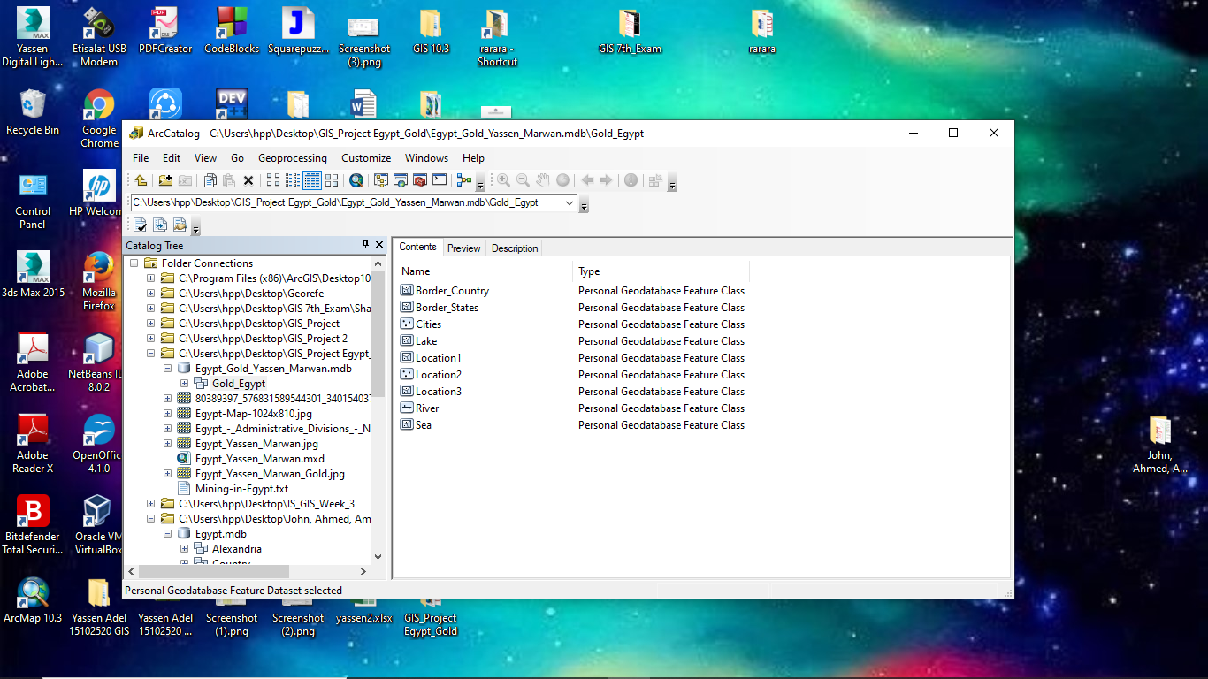
How we use ArcGIS to afford our Goal
We create our Data using ArcCatalog to create feature classes in feature dataset ,personal database called Egypt_Gold_Yassen_Marwan within it feature Dataset called Gold_Egypt within it our classes with different attributes as shown below .

Slide 4
Cont.
We use these classes to specify attributes and features (polygons ,points and lines ).
Every involving sea use feature polygons.
Every city using feature point.
Every lake using feature lines.
And we will show using screenshots. In the next slides.

Slide 5
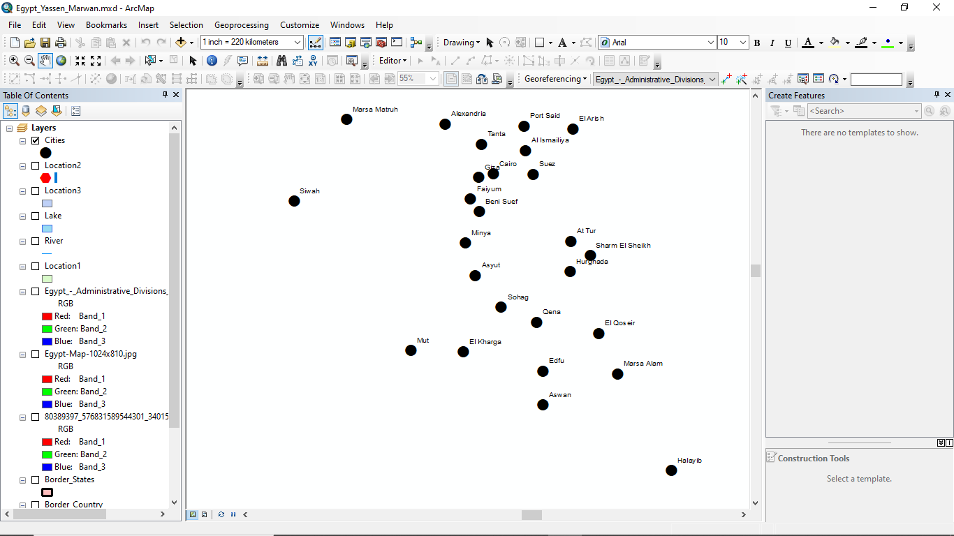
Screenshots with explanation:
This is the cities in Egypt with feature point.

Slide 6
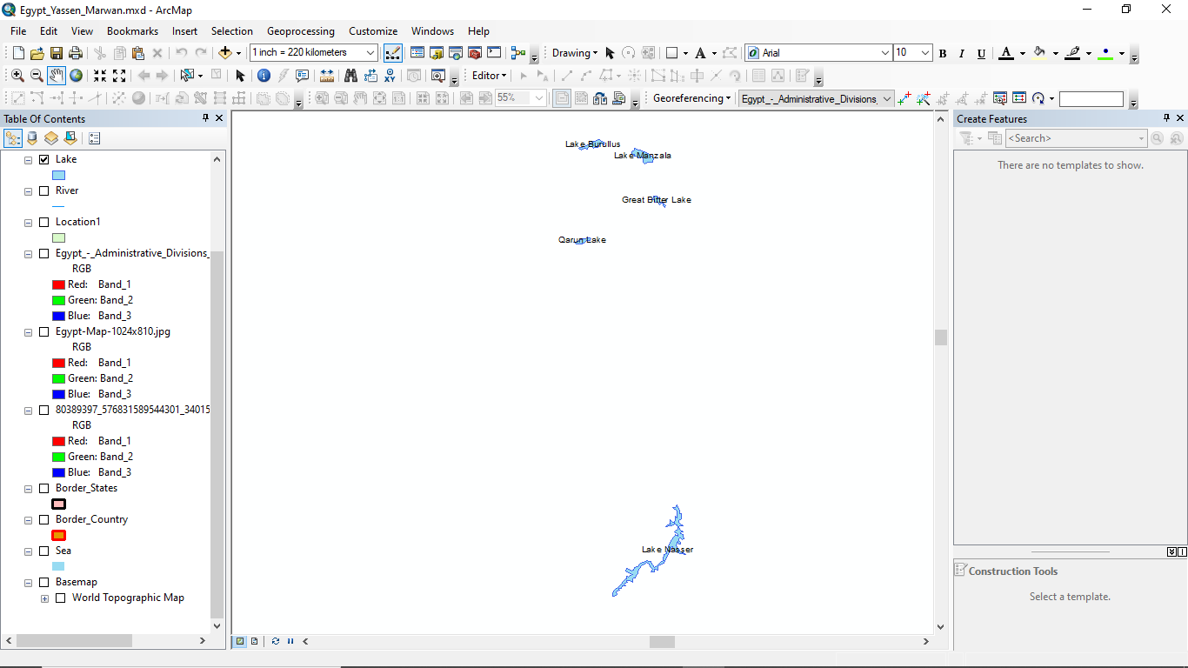
Cont. Classes with their Features:
This is the lakes using Polygon Features.

Slide 7
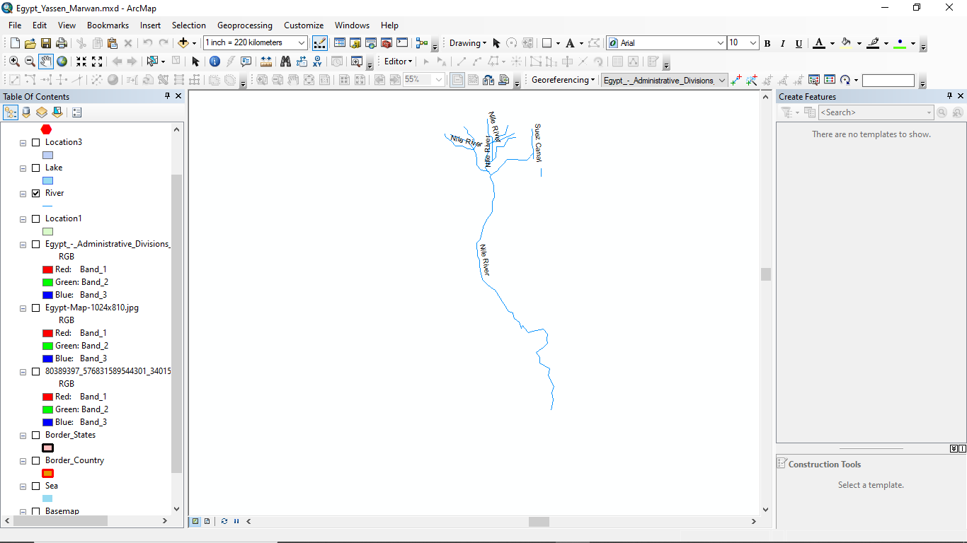
Cont.
This is the rivers of Egypt explained in line features.

Slide 8
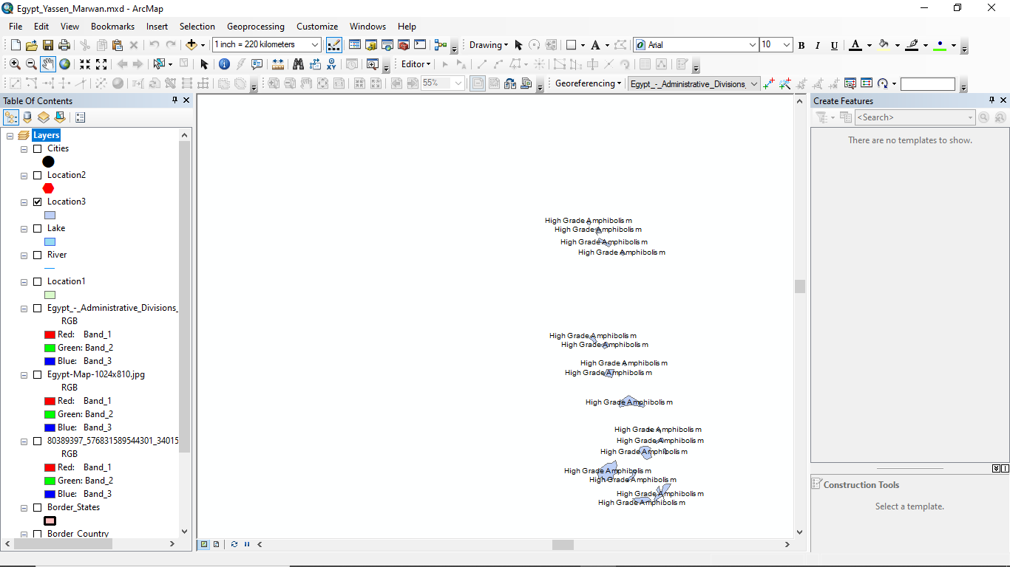
Locations of another valuable rocks used in metal is location 1 and 3.
This is the locations of another valuable rocks used in important metals manfuacturers (amphobilism), this is location 3

Slide 9
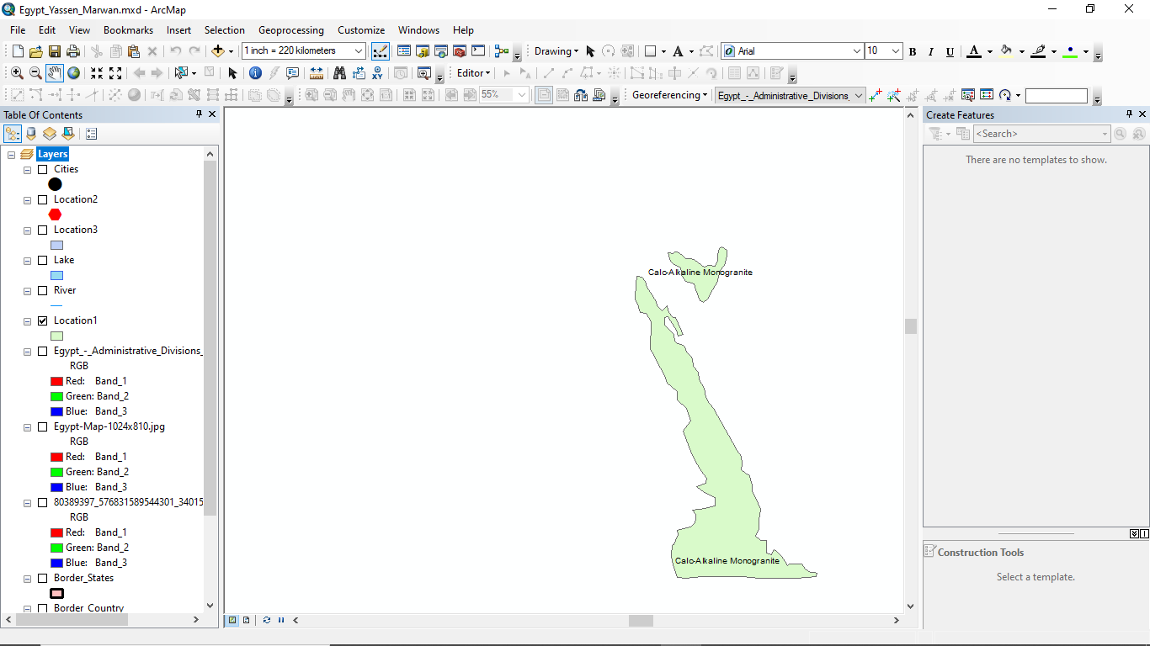
Cont. Locations:
This is location 1 used for (Calc- Alkaline Monogranite)

Slide 10
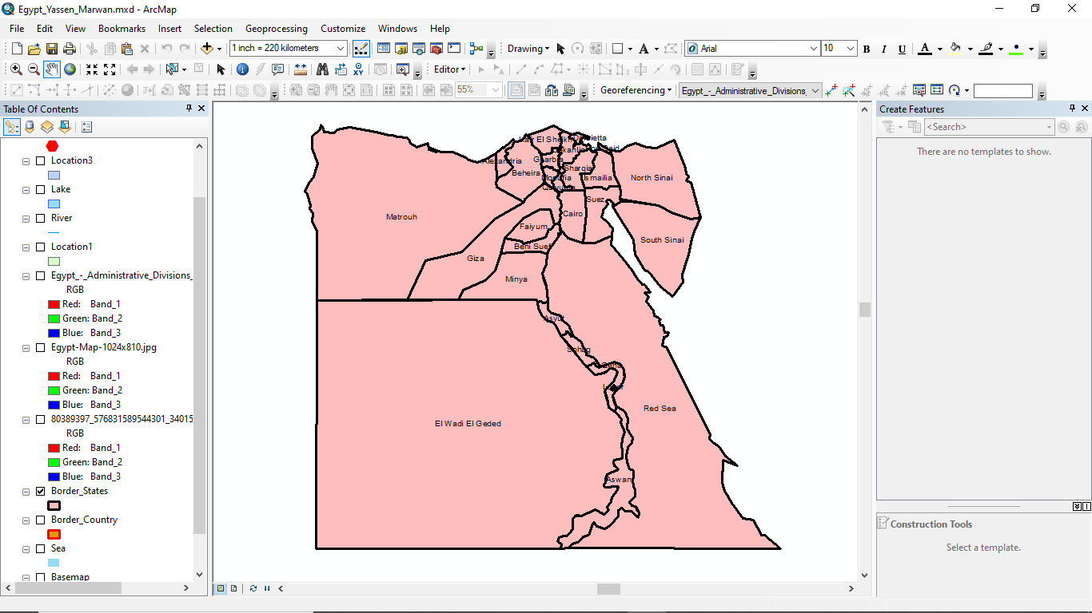
Cont. Locations ( border states ).
This is our borders states using Polygons.

Slide 11
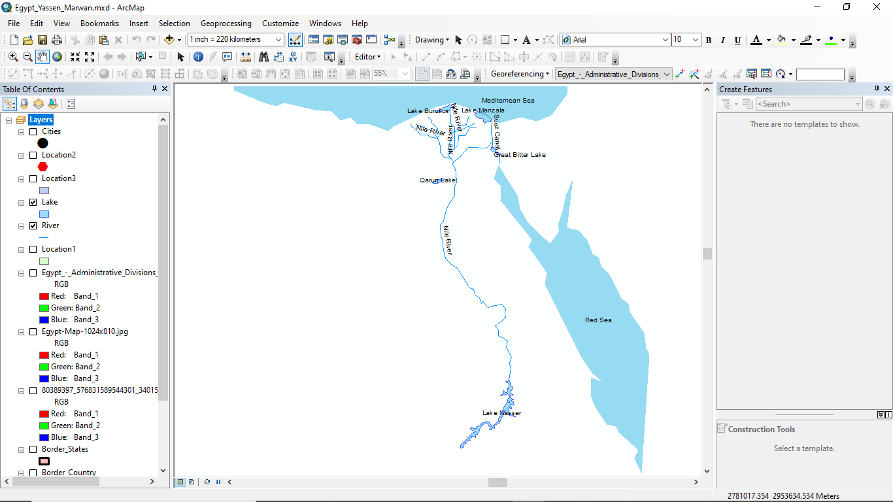
This is the seas in our project using polygon features .

Slide 12
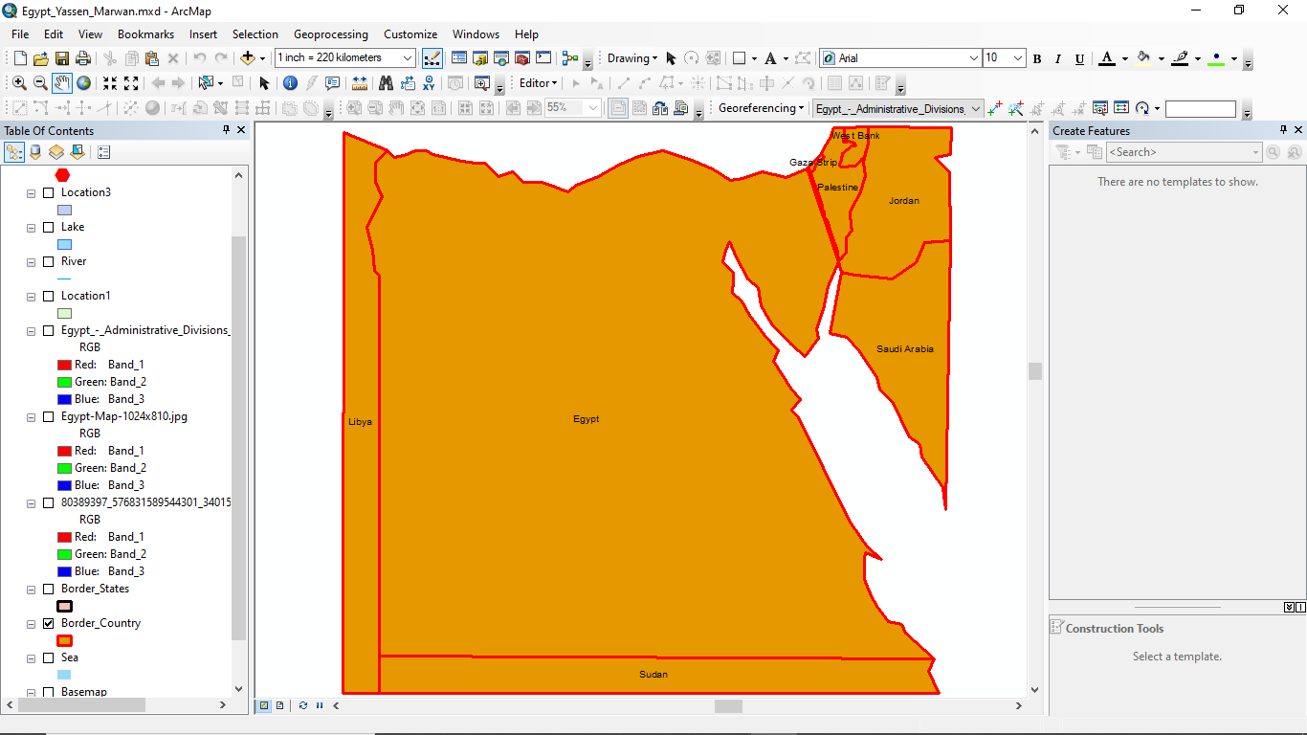
This is the border country by polygon feature:

Slide 13
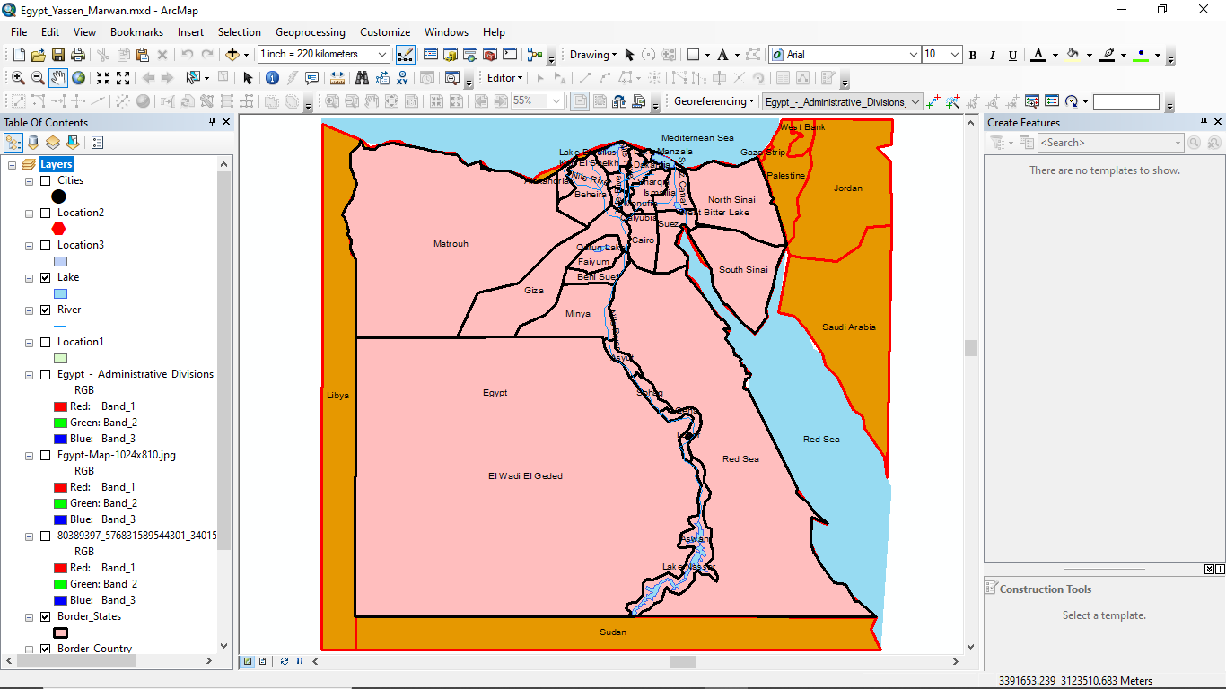
This is the cities , lakes , seas and the whole project.

Slide 14
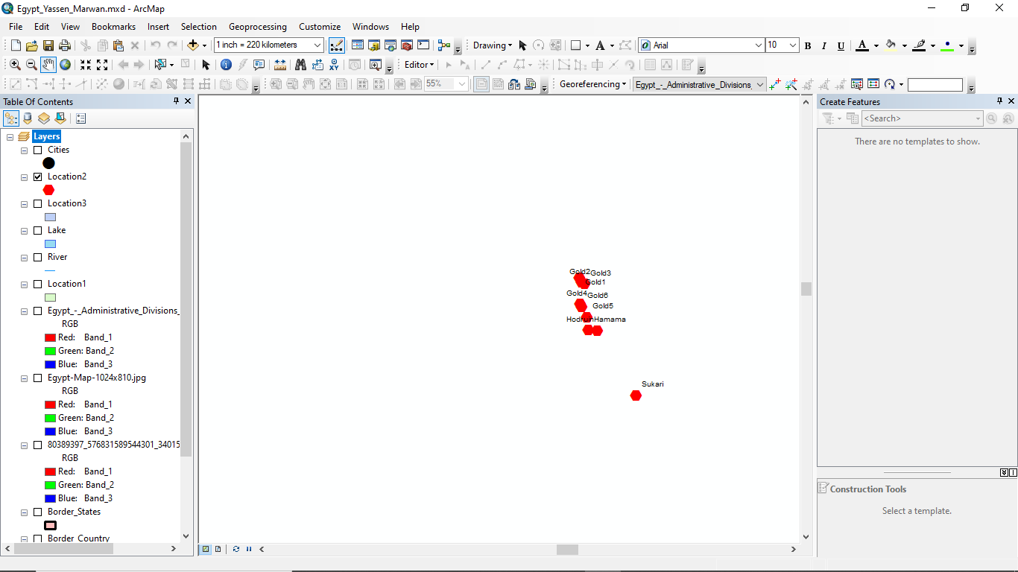
This is the location of our gold mines.

Slide 15
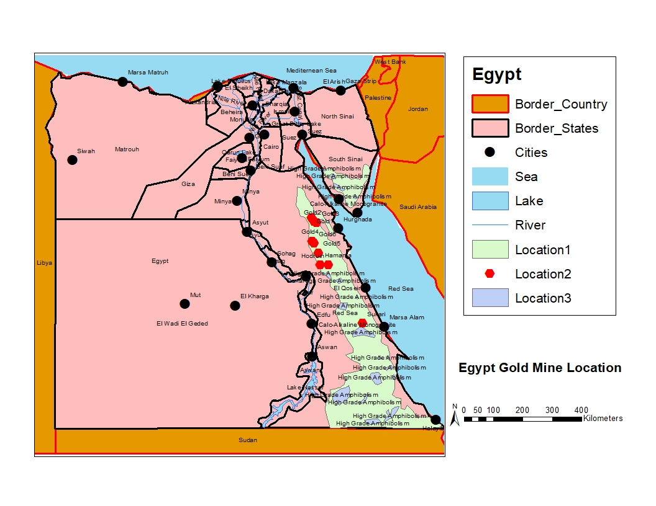
This is the whole map.

Slide 16
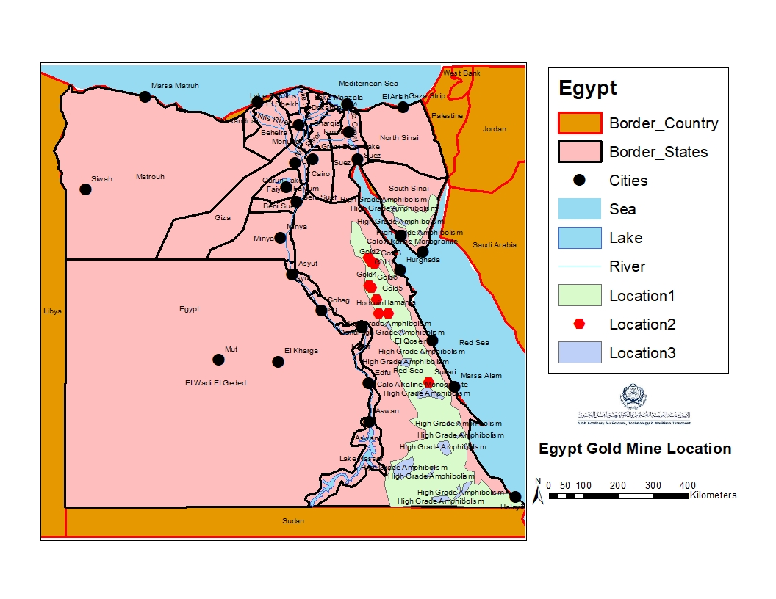
The final view of our project.

Slide 17

Conclusion.
We have enter the data in our project to conclude the locations of the places including valuable rocks , places to mine for gold and we hope everything is as obvious as possible and we hope informing you of how we managed to use ArGis Software.

