Slide 1
Norway
Presented by: Yassen Adel
Reg. no: 15102520

Slide 2
Contents:-
Introduction
Geography
Politics
Economy
Industrial and trading
Demographics
Culture

Slide 3
Introduction:
Norway, officially the Kingdom of Norway, is a Nordic country in Northern Europe whose territory comprises the western and northernmost portion of the Scandinavian Peninsula; the remote island of Jan Mayen and the archipelago of Svalbard are also part of the Kingdom of Norway. The Antarctic Peter I Island and the sub-Antarctic Bouvet Island are dependent territories and thus not considered part of the kingdom. Norway also lays claim to a section of Antarctica known as Queen Maud Land. Norway has a total area of 385,207 square kilometres (148,729 sq mi) and a population of 5,312,300 (as of August 2018). The country shares a long eastern border with Sweden (1,619 km or 1,006 mi long). Norway is bordered by Finland and Russia to the north-east, and the Skagerrak strait to the south, with Denmark on the other side. Norway has an extensive coastline, facing the North Atlantic Ocean and the Barents Sea. The capital of Norway is Oslo, it is the economic and governmental centre of Norway. The city is also a hub of Norwegian trade, banking, industry and shipping. It is an important centre for maritime industries and maritime trade in Europe. The city is home to many companies within the maritime sector, some of which are among the world's largest shipping companies, shipbrokers and maritime insurance brokers. Oslo is a pilot city of the Council of Europe and the European Commission intercultural cities programme.

Slide 4
Geography:
Norway is one of the world's most northerly countries, and one of Europe's most mountainous countries with large areas dominated by the Scandinavian Mountains; average elevation is 460 metres (1,510 ft) and 32% of the mainland is located above the tree line.
Virtually the entire country was covered with a thick ice sheet during the last ice age, as well as in many earlier ice ages. The movement of the ice carved out deep valleys, and when the ice melted, the sea filled many of these valleys, creating Norway's famous fjords.

Slide 5
Politics:
The politics of Norway take place in the framework of a parliamentary representative democratic constitutional monarchy. Executive power is exercised by the king, the Council of State, the cabinet, led by the Prime Minister of Norway. Legislative power is vested in both the government and the legislature, the Storting elected within a multi-party system. The judiciary is independent of the executive branch and the legislature.
The Economist Intelligence Unit rated Norway as a "full democracy" in 2016.

Slide 6
Economy:
The economy of Norway is a developed mixed economy with state-ownership in strategic areas. Although sensitive to global business cycles, the economy of Norway has shown robust growth since the start of the industrial era. The country has a very high standard of living compared with other European countries, and a strongly integrated welfare system. Norway's modern manufacturing and welfare system rely on a financial reserve produced by exploitation of natural resources, particularly North Sea oil.
According to United Nations data for 2016, Norway together with Luxembourg (a small state) and Switzerland are the only three countries in the world with a GDP per capita above US$70,000 that are not island nations nor microstates.

Slide 7
Industrial and Trading:
The Norwegian economy is small and the country has a relatively uniform industrial structure. Compared with many other countries, therefore, it has a high share of exports and imports. A major part of Norway’s exports and imports is to and from areas near to us, as shown by the figure below. Seventy-four per cent of Norway’s exports go to the EU, while just over 68 per cent of its imports come from this area. Exports to the USA are at around the same level as those to Asia, but Norway imports much more from Asia than the USA. The Nordic countries, the UK and Germany are Norway’s most important trading partners. The UK and Germany buy significantly larger amounts of Norwegian export products than Sweden or Denmark, for instance. This is due, among other things, to the fact that the first two countries are large markets for Norway’s oil and gas. Sweden is the individual country from which we import most goods.

Slide 8
Continue:
All of Norway’s industries have increased their exports over the past 20 years - by a total of 270 per cent. The petroleum industry is currently the most important export sector, accounting for 46 per cent of Norway’s export revenues. This is followed by the manufacturing industry, with around 30 per cent, and the services industry, with around 20 per cent. This picture was very different in 1980. Service industries then accounted for 34 per cent of the Norwegian export figures. More than two-thirds of these were linked to the shipping industry, but this share has been cut to around 50 per cent over the past few years. The traditional manufacturing industry accounted for 33 per cent of the export revenues and the petroleum sector for 28 per cent in 1980. The primary industries did not export much at that time, but, as a result of the increased export of Norwegian fish, they now account for 2 per cent of the export figures. Processed fish and fish products are classified as industrial products.
Norway’s major export products are gas and oil, which have an export value of more than NOK 312 billion, or 46 per cent of the country’s total exports in 2000.
The gross domestic product, or GDP is a measure of the value creation in all the goods and services produced by a country in the space of a year. In 2000, Norway’s total GDP came to NOK 1 424 billion. The private-services sector accounts for 40 per cent of Norway’s GDP, making it the highest contributor.

Slide 9
Demographics:
The total population of Norway on 1 January 2018 was 5,295,619. Statistics Norway estimated that the 5,000,000 milestone was reached on 19 March 2012.
Ethnically, the residents of Norway are predominantly Norwegians, a North Germanic ethnic group descent. In Northern Norway live the Sami, who claim descent from people who settled the area around 8,000 years ago, probably from continental Europe through the Norwegian coast and through Finland along the inland glaciers. As of 2012, an official government study shows that 86.2% of the total population are ethnic Norwegians. The national minorities of Norway include Scandinavian Romani, Roma, Jews, and Kvener, as well as a small Finnish community.
Birth rate
12.2 births/1,000 population (2018 est.) Country comparison to the world: 160th
Death rate
8 deaths/1,000 population (2018 est.) Country comparison to the world: 90th

Slide 10
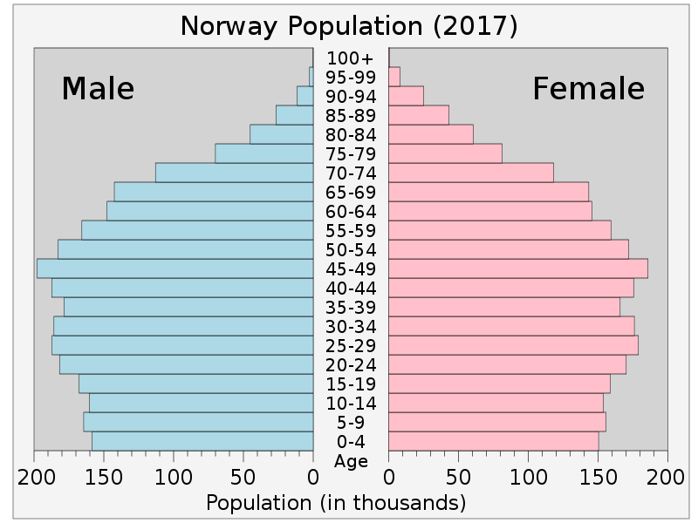
Continue:

Slide 11
Continue:
Languages
Norwegian and Sami
Bokmål (official written only), Nynorsk (official written only), North Sami, Lule Sami, and South Sami
Note: There is no standardized spoken Norwegian. Sami is an official language in nine municipalities in Norway's three northernmost counties: Finnmark, Nordland, and Troms. There are also Finnish-speaking minorities.
Religions
Church of Norway (Evangelical Lutheran - official) 71.5%, Roman Catholic 2.8%, other Christian 3.9%, Muslim 2.8%, other 2%, unspecified 7.5% (2016 est.)
Sex ratio
at birth: 1.05 male(s)/female (2004 est.), under 15 years: 1.05 male(s)/female, 15–64 years: 1.04 male(s)/female, 65 years and over: 0.72 male(s)/female, total population: 0.98 male(s)/female

Slide 12
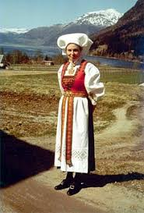
Culture:

Slide 13
Continue:
The culture of Norway is closely linked to the country's history and geography. The unique Norwegian farm culture, sustained to this day, has resulted not only from scarce resources and a harsh climate but also from ancient property laws. In the 19th century, it brought about a strong romantic nationalistic movement, which is still visible in the Norwegian language and media. In the 19th century, Norwegian culture blossomed as efforts continued to achieve an independent identity in the areas of literature, art and music. This continues today in the performing arts and as a result of government support for exhibitions, cultural projects and artwork.

