Slide 1

Project Requirements
Presented by: Yassen Adel Mohamed
Registration Number: 15102520
Presented to: Lecture: Prof. Dr. Osama Badawy
Section: Eng. Nagham Mohamed

Slide 2
Contents:
Introduction
Expert System
Expert System Project
Modeling and Analysis using Linear Programming
Linear Programming Project
Data Mining
Data Mining Project
Web Mining
Web Mining Project
References

Slide 3
Introduction
A decision support system (DSS) is an information system that supports business or organizational decision-making activities.
DSSs serve the management, operations and planning levels of an organization (usually mid and higher management) and help people make decisions about problems that may be rapidly changing and not easily specified in advance—i.e. unstructured and semi-structured decision problems.
Decision support systems can be either fully computerized or human-powered, or a combination of both.

Slide 4
Expert System
An expert system is a computer system that emulates the decision-making ability of a human expert.
Expert systems are designed to solve complex problems by reasoning through bodies of knowledge, represented mainly as if–then rules rather than through conventional procedural code.
An expert system is divided into two subsystems: the inference engine and the knowledge base.

Slide 5
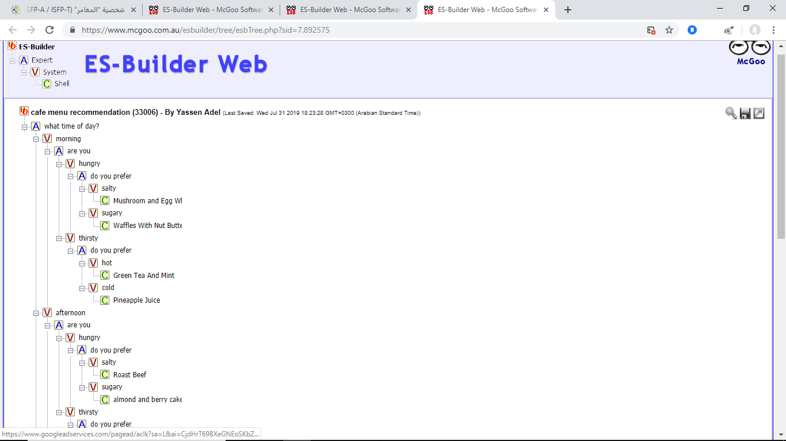
Expert System Project
Build an Expert system using (www.mcgoo.com.au).

Slide 6
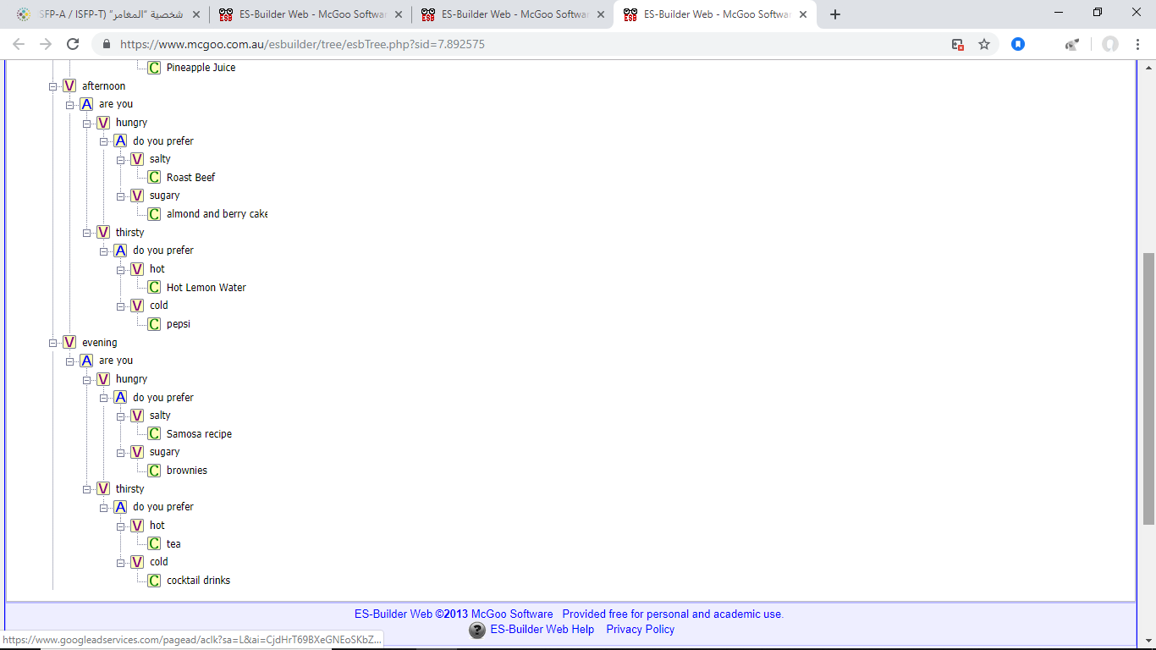
Expert System Project Cont.

Slide 7
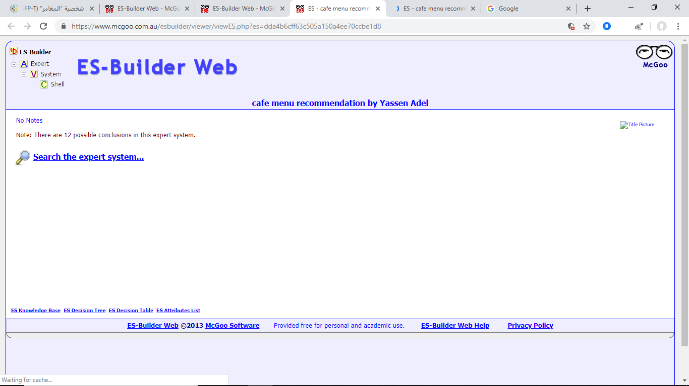
Expert System Project Cont.

Slide 8
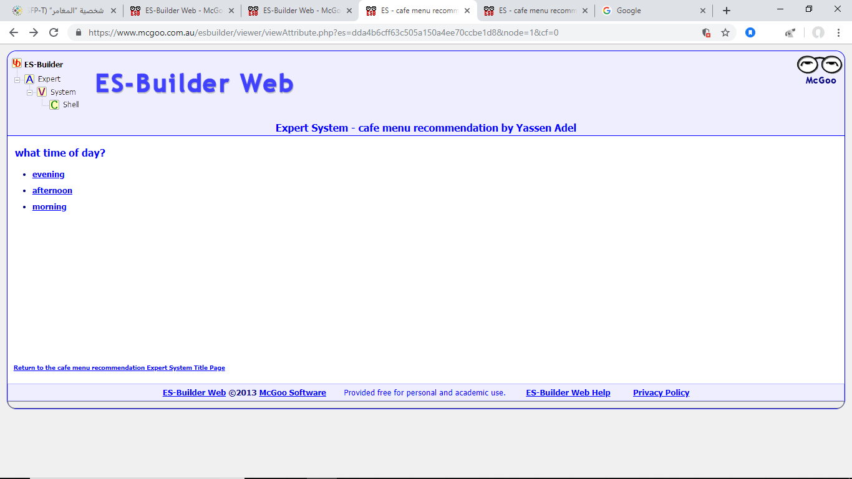
Expert System Project Cont.

Slide 9
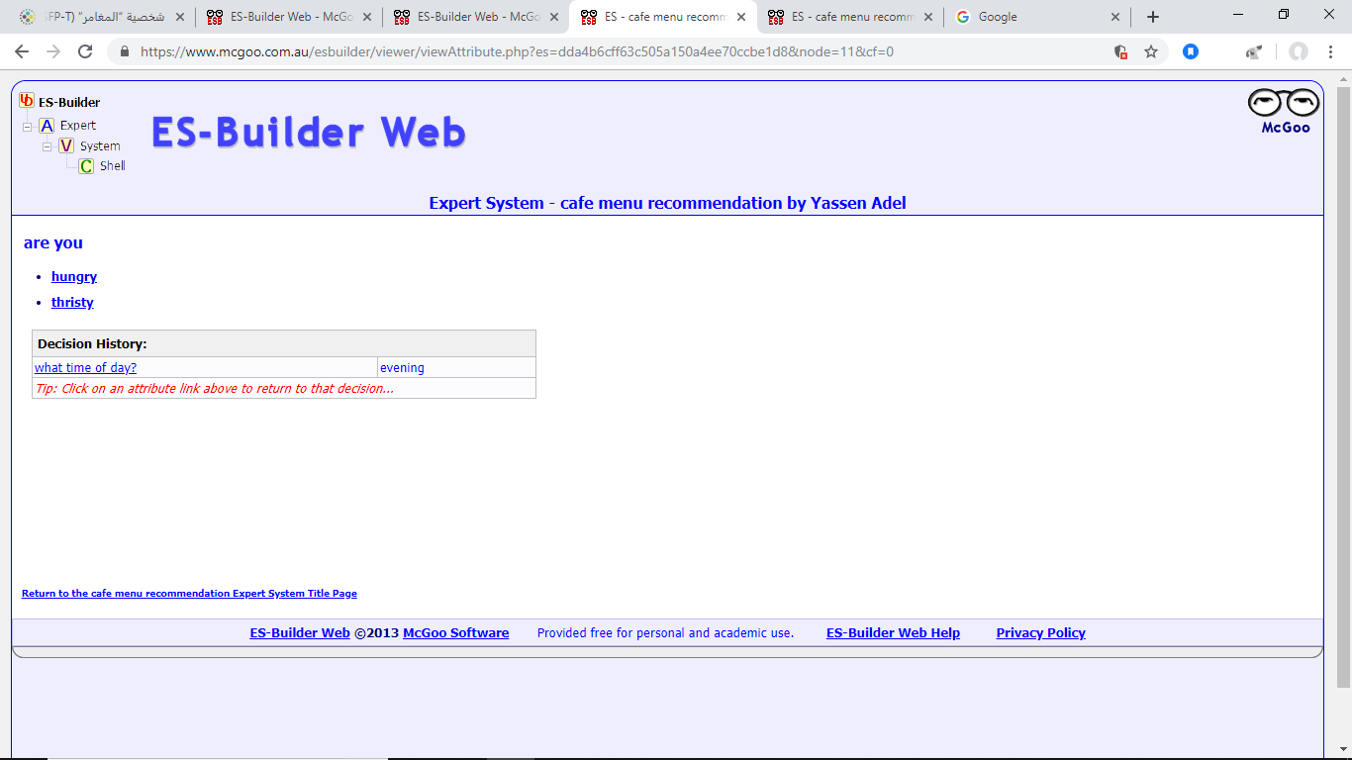
Expert System Project Cont.

Slide 10
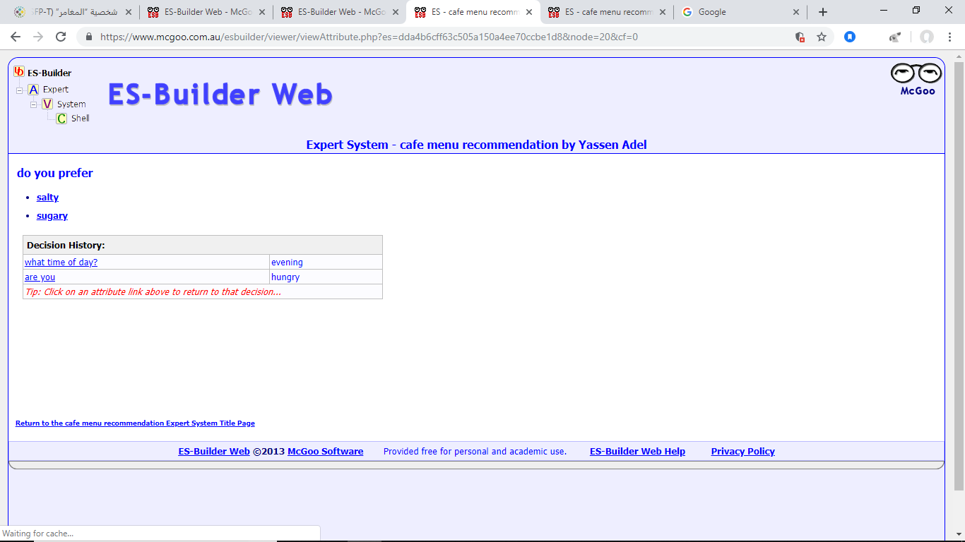
Expert System Project Cont.

Slide 11
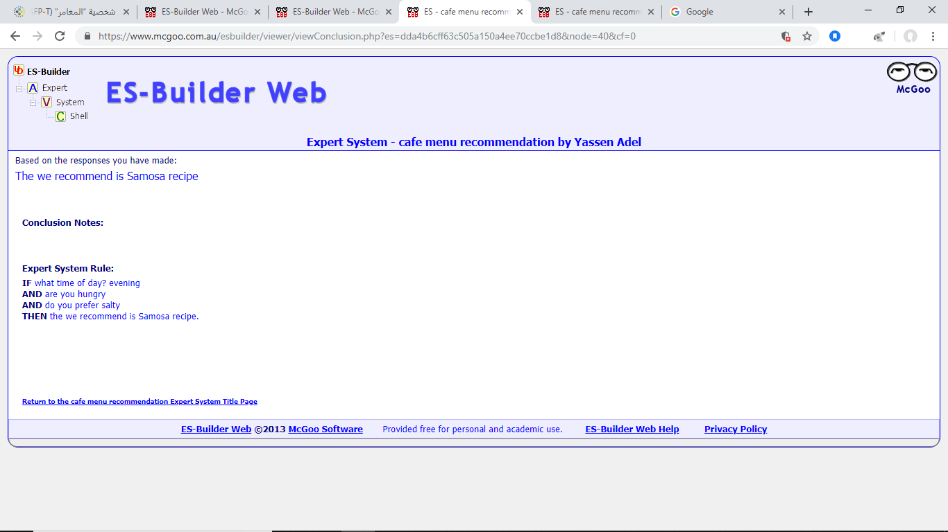
Expert System Project Cont.

Slide 12
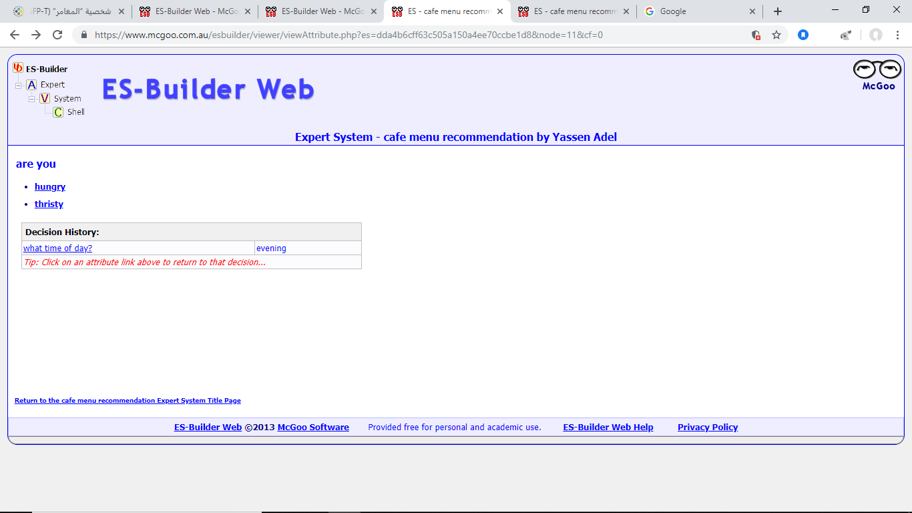
Expert System Project Cont.

Slide 13
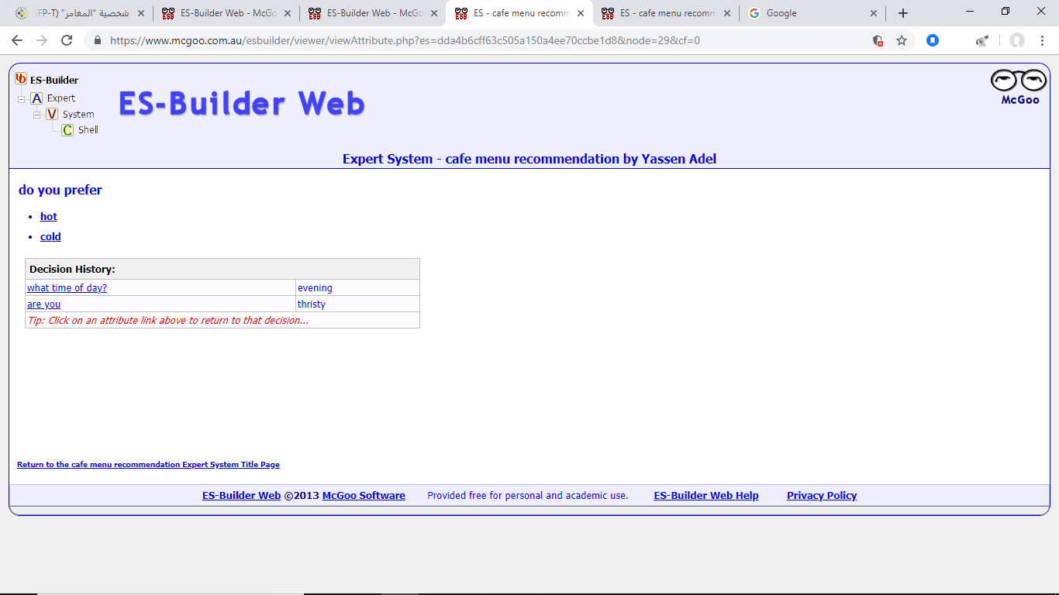
Expert System Project Cont.

Slide 14
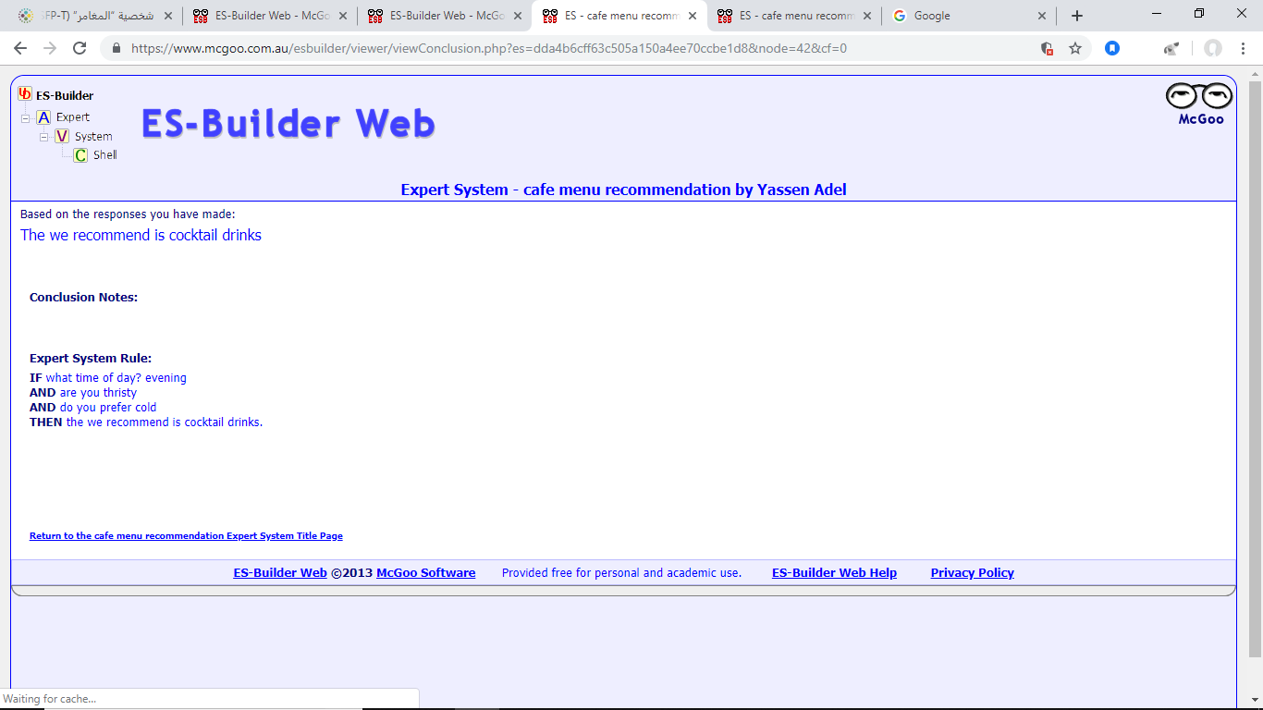
Expert System Project Cont.

Slide 15
Modeling and Analysis using Linear Programming
Linear programming is a simple technique where we depict complex relationships through linear functions and then find the optimum points.
The important word in previous sentence is depict.
Applications of linear programming are every where around you.
You use linear programming at personal and professional fronts.
You are using linear programming when you are driving from home to work and want to take the shortest route.
Steps: Identify the Decision Variables, Write the Objective Function, Mention the Constraints, Explicitly States the Non-negativity restriction.

Slide 16
Linear Programming Project
Solve the following question using excel solver:
You have $12,000 to invest and three different funds from which to choose .the municipal bond fund has a 7% return , the local bank’s CDs have an 8% return, and the high-risk account has an expected 12% return. To minimize the risk, you decide not to invest any more than $2,000 in the high –risk account. For tax reasons, you need to invest at least three times as much in municipal bond as in the bank CDs. Assume the year-end yields are expected. What are the optimal investment amounts?

Slide 17
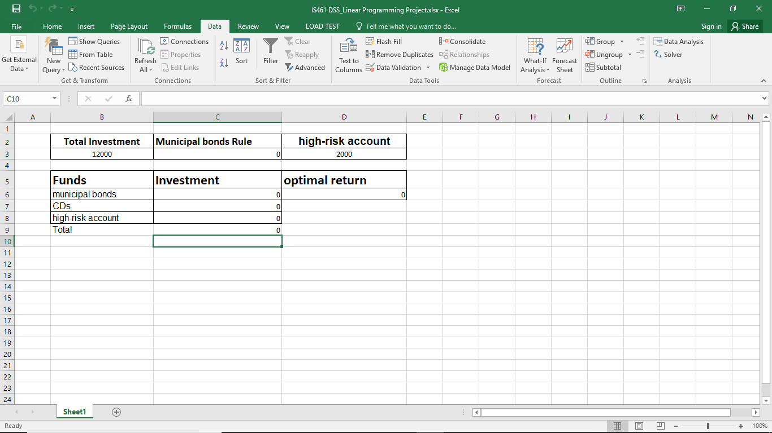
Linear Programming Project cont.

Slide 18
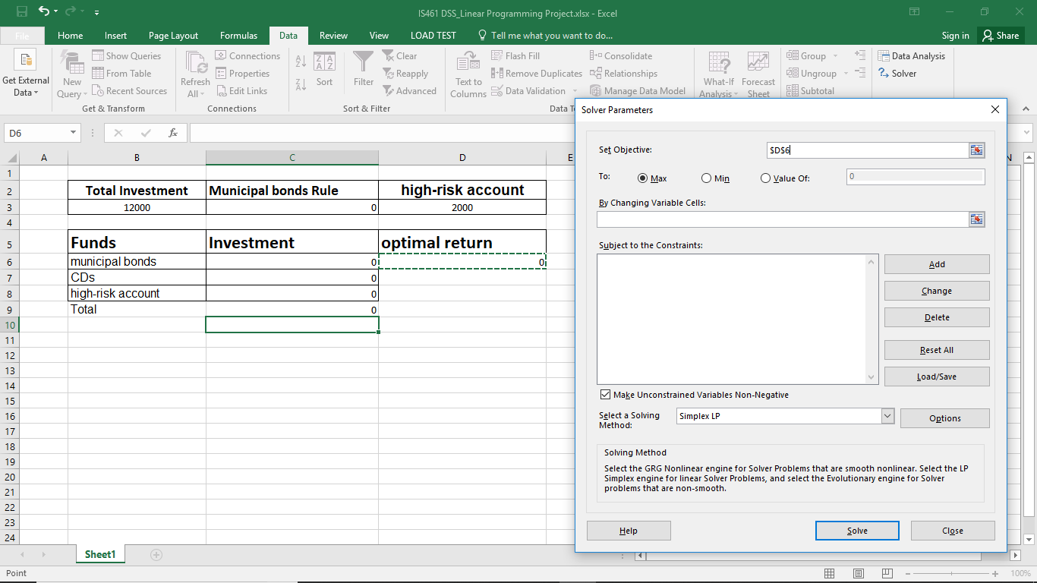
Linear Programming Project cont.

Slide 19
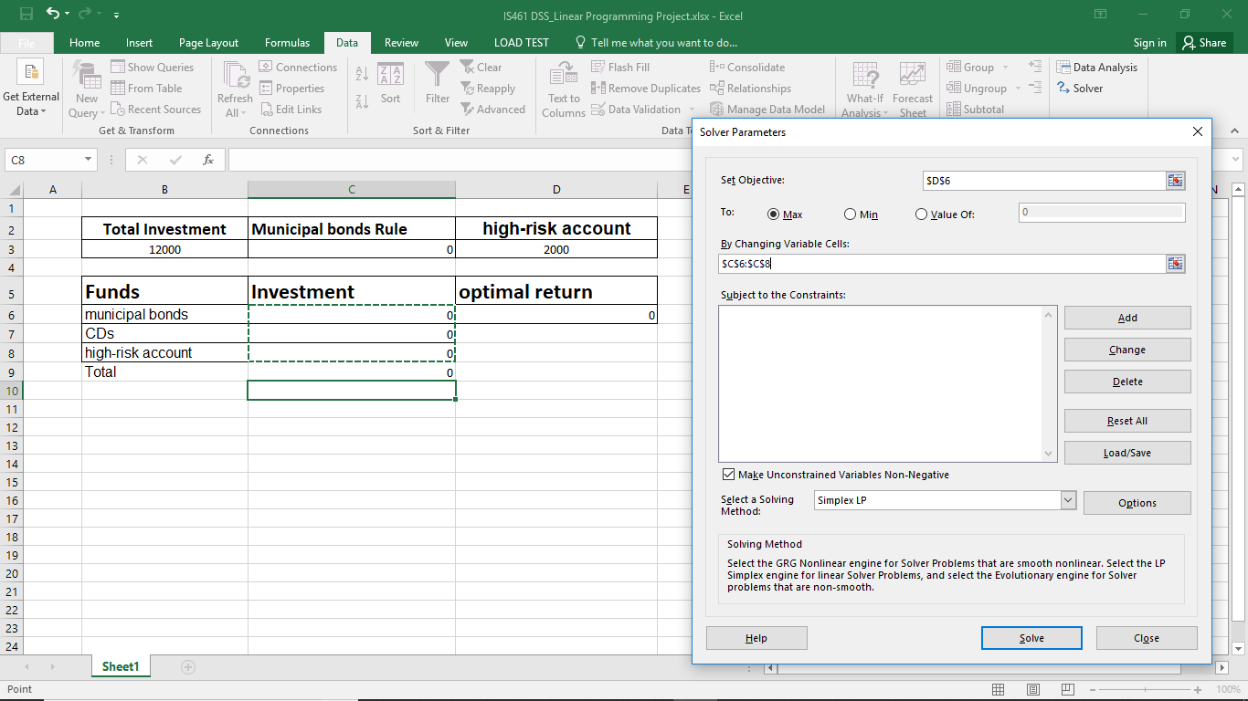
Linear Programming Project cont.

Slide 20
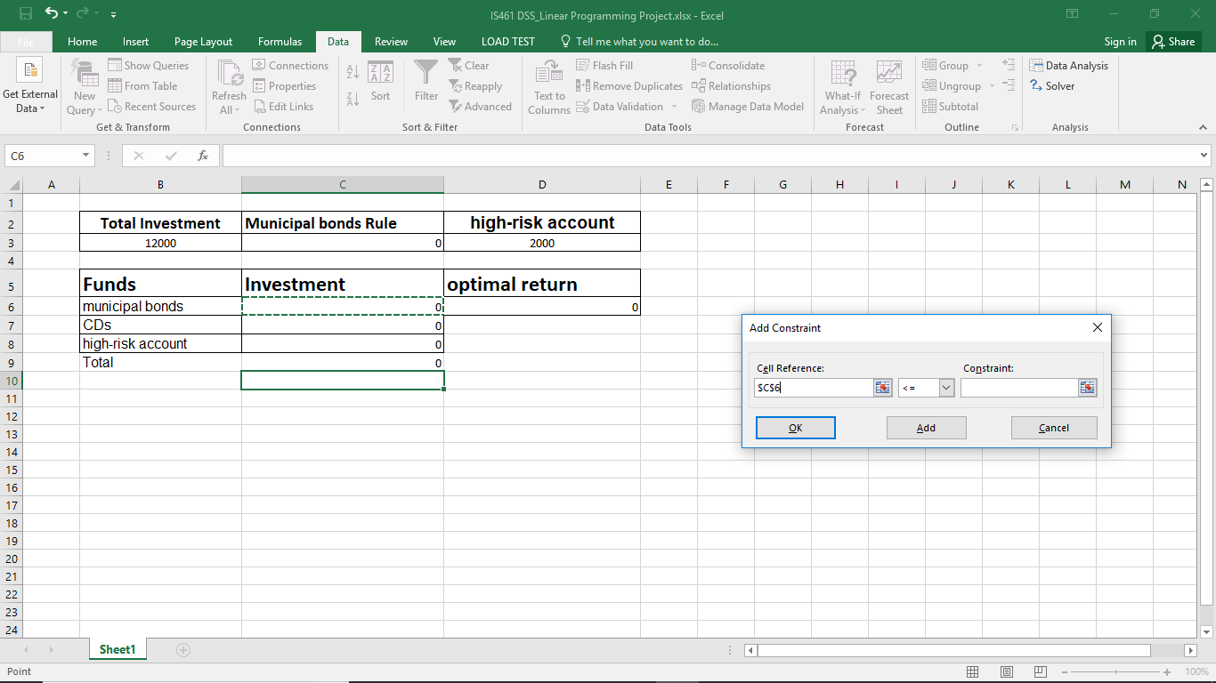
Linear Programming Project cont.

Slide 21

Linear Programming Project cont.

Slide 22

Linear Programming Project cont.

Slide 23
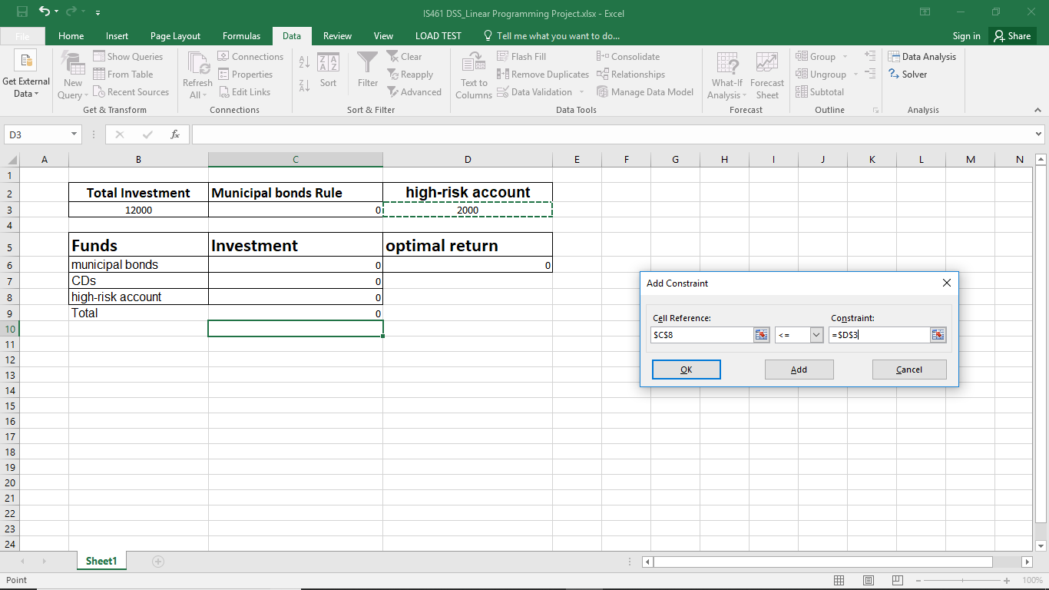
Linear Programming Project cont.

Slide 24

Linear Programming Project cont.

Slide 25

Linear Programming Project cont.

Slide 26
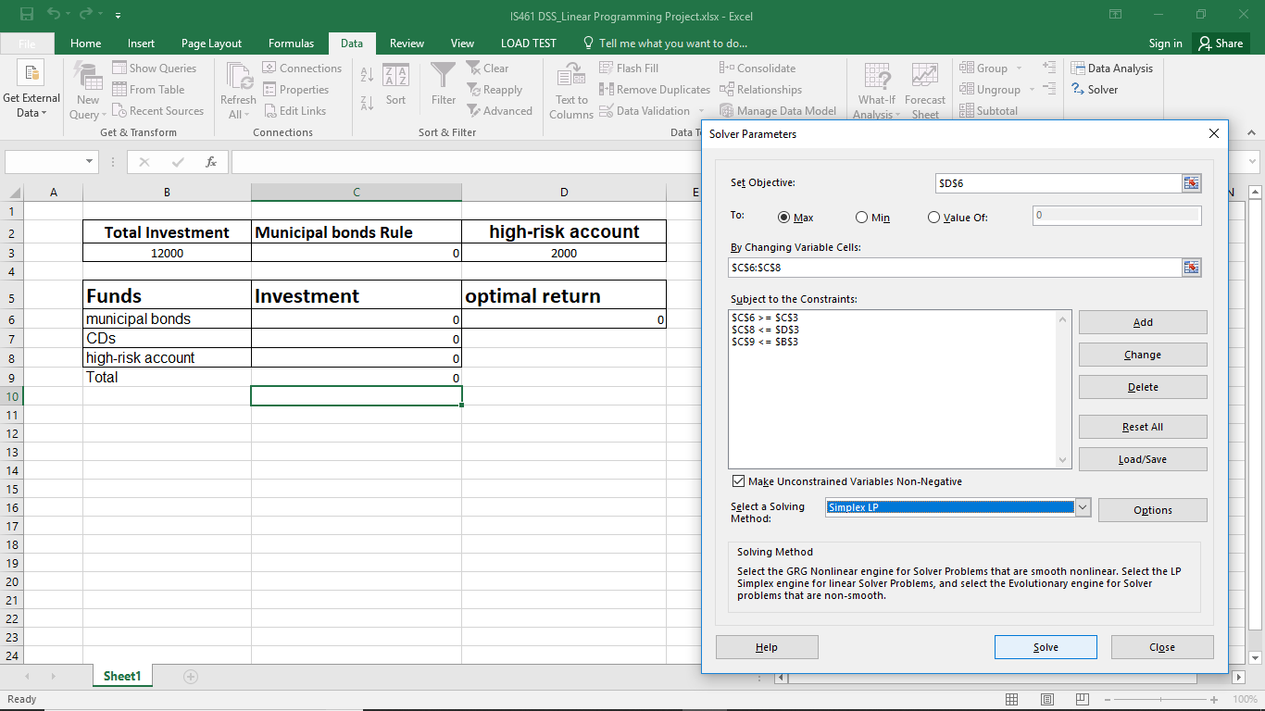
Linear Programming Project cont.

Slide 27
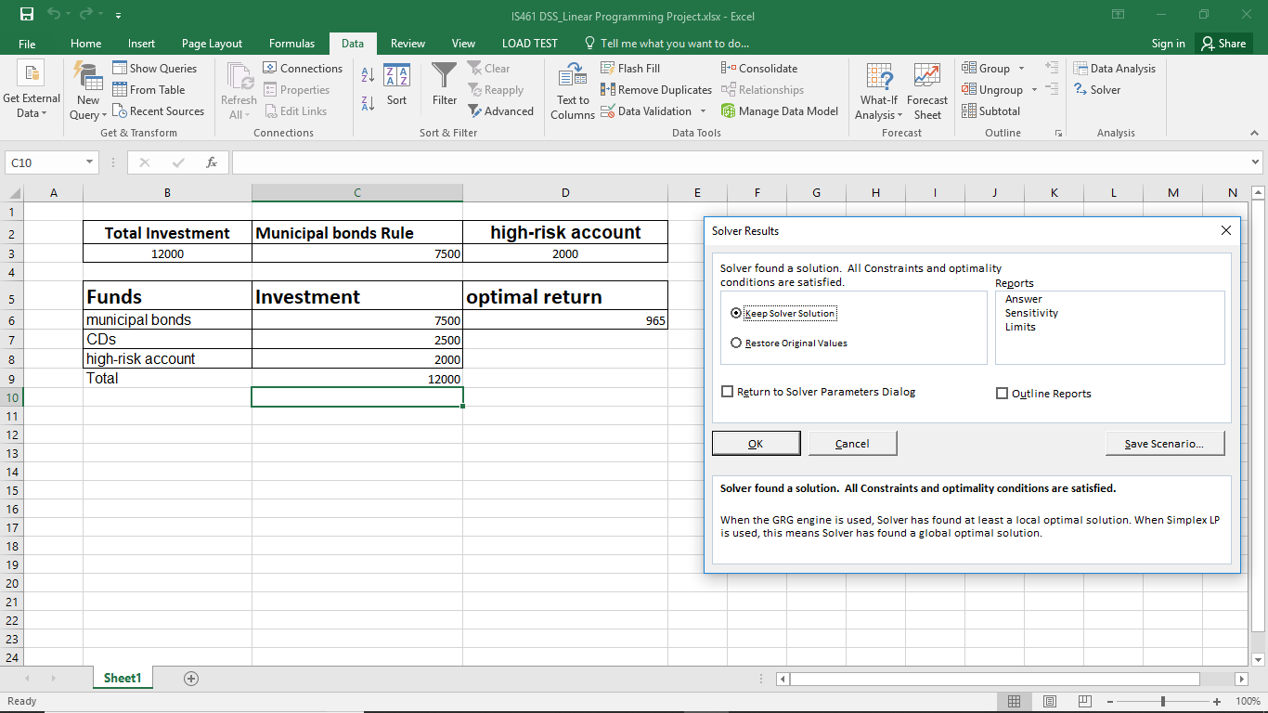
Linear Programming Project cont.

Slide 28
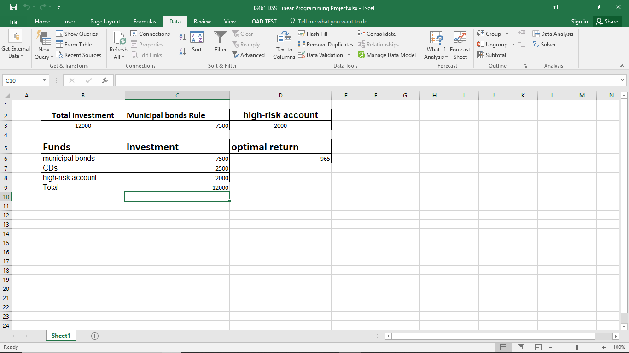
Linear Programming Project cont.

Slide 29
Data Mining
Data mining is the process of finding anomalies, patterns and correlations within large data sets to predict outcomes.
The process of digging through data to discover hidden connections and predict future trends has a long history. Sometimes referred to as "knowledge discovery in databases," the term "data mining" wasn’t coined until the 1990s.
Scientific disciplines: statistics (the numeric study of data relationships), artificial intelligence (human-like intelligence displayed by software and/or machines) and machine learning (algorithms that can learn from data to make predictions).

Slide 30
Data Mining Project
Solve the following questions using rapid miner:
Question one: (General Data Mining Technique)
Apply a decision tree model to titanic data set to predict who survived and who didn’t.
Measure the performance of your model.

Slide 31
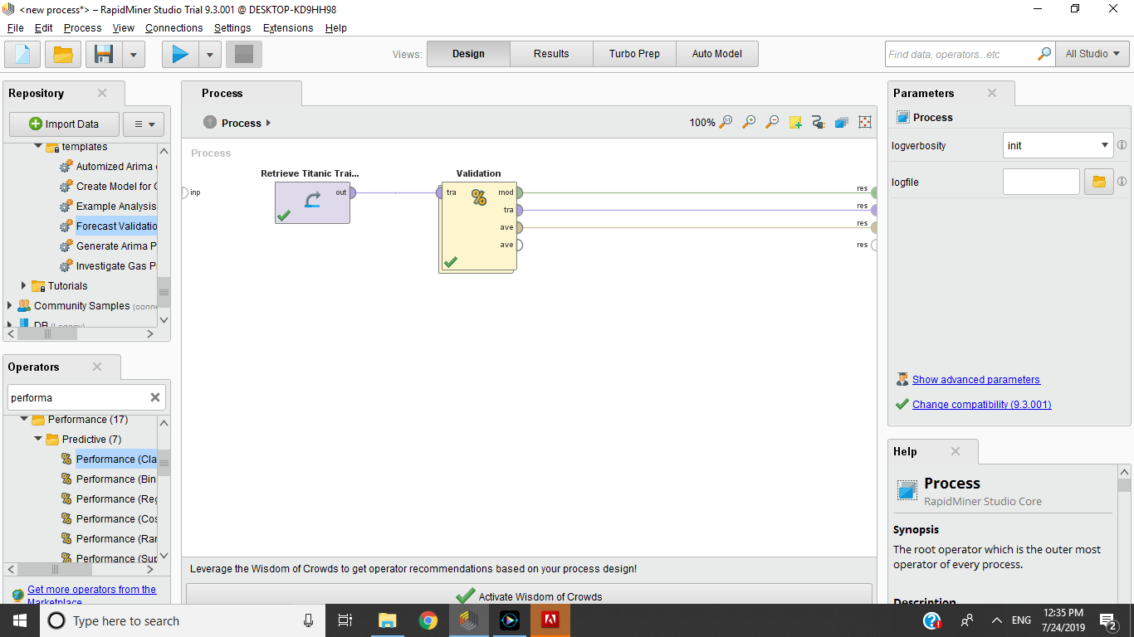
Data Mining Project Cont.

Slide 32
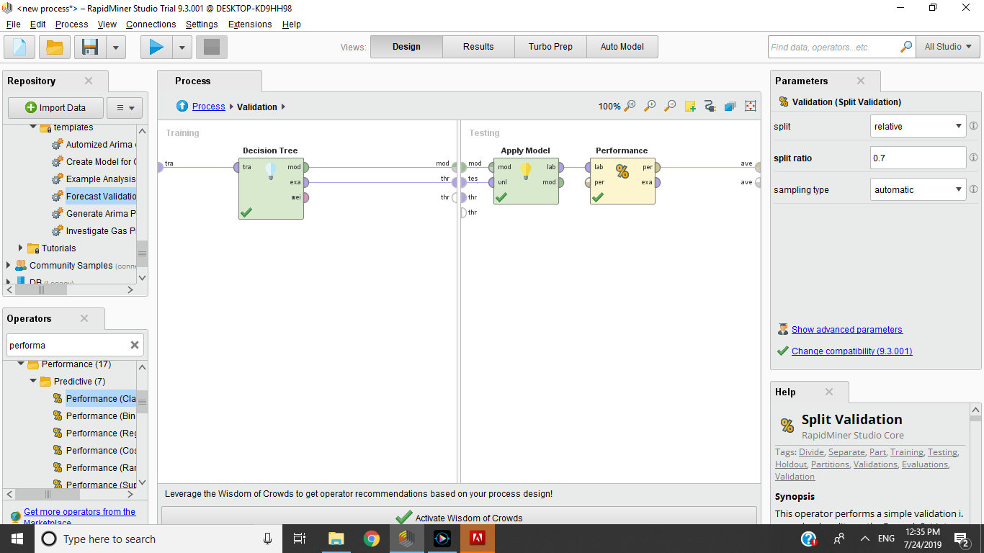
Data Mining Project Cont.

Slide 33
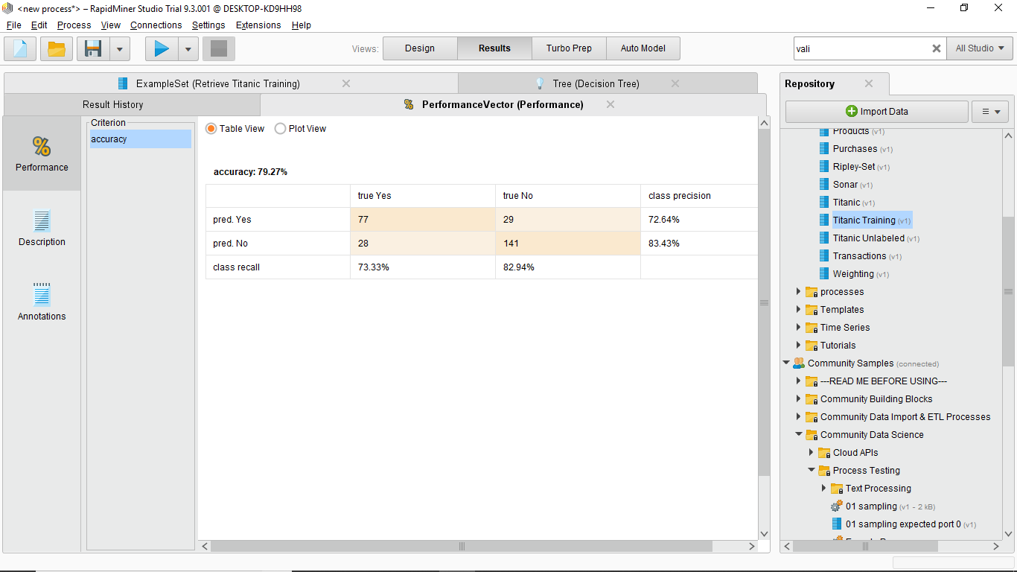
Data Mining Project Cont.

Slide 34
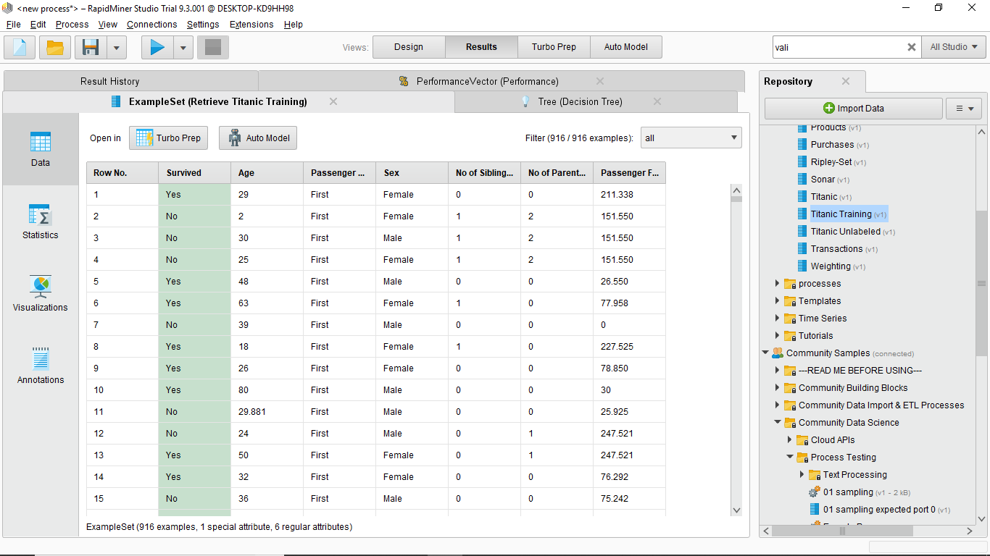
Data Mining Project Cont.

Slide 35
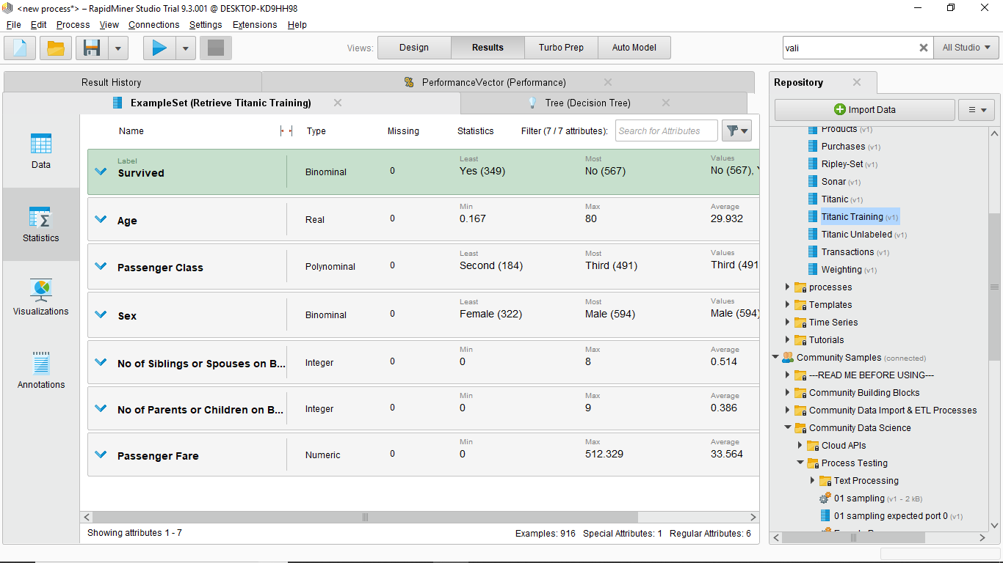
Data Mining Project Cont.

Slide 36
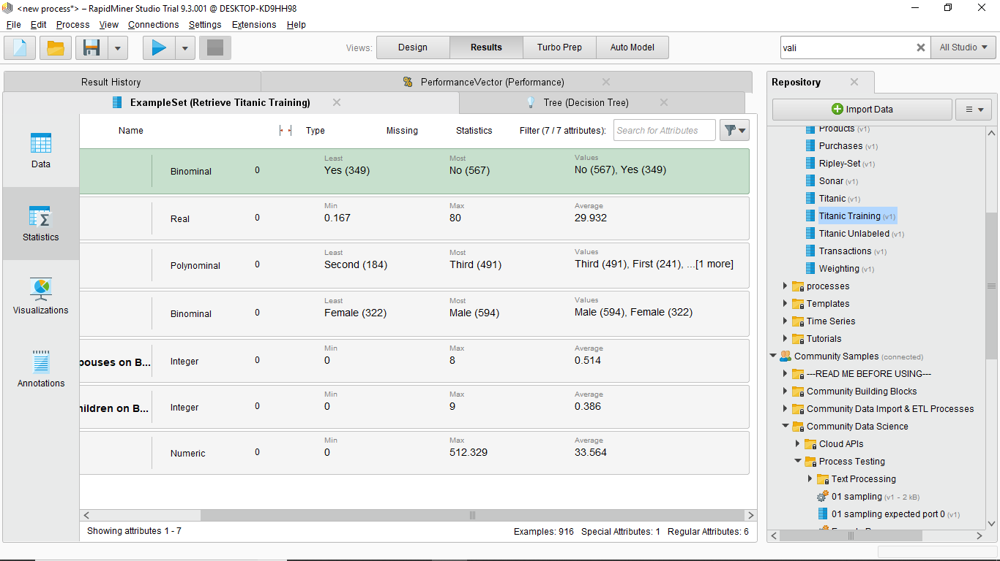
Data Mining Project Cont.

Slide 37
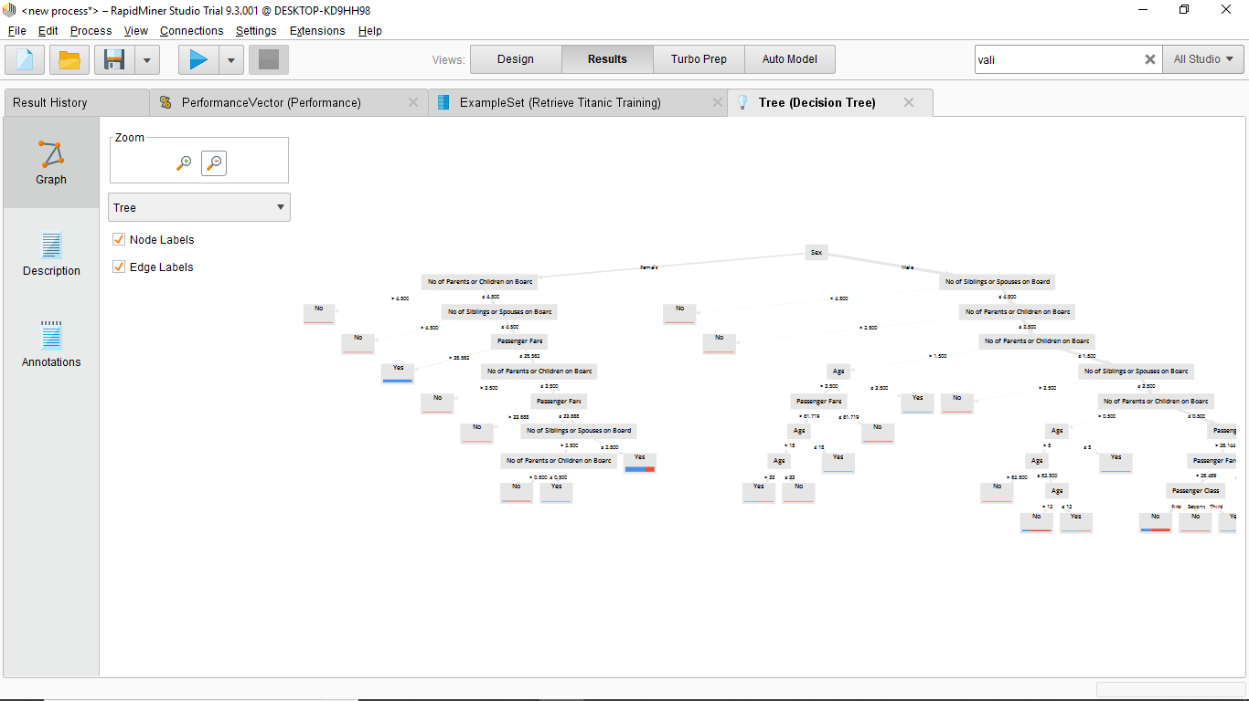
Data Mining Project Cont.

Slide 38
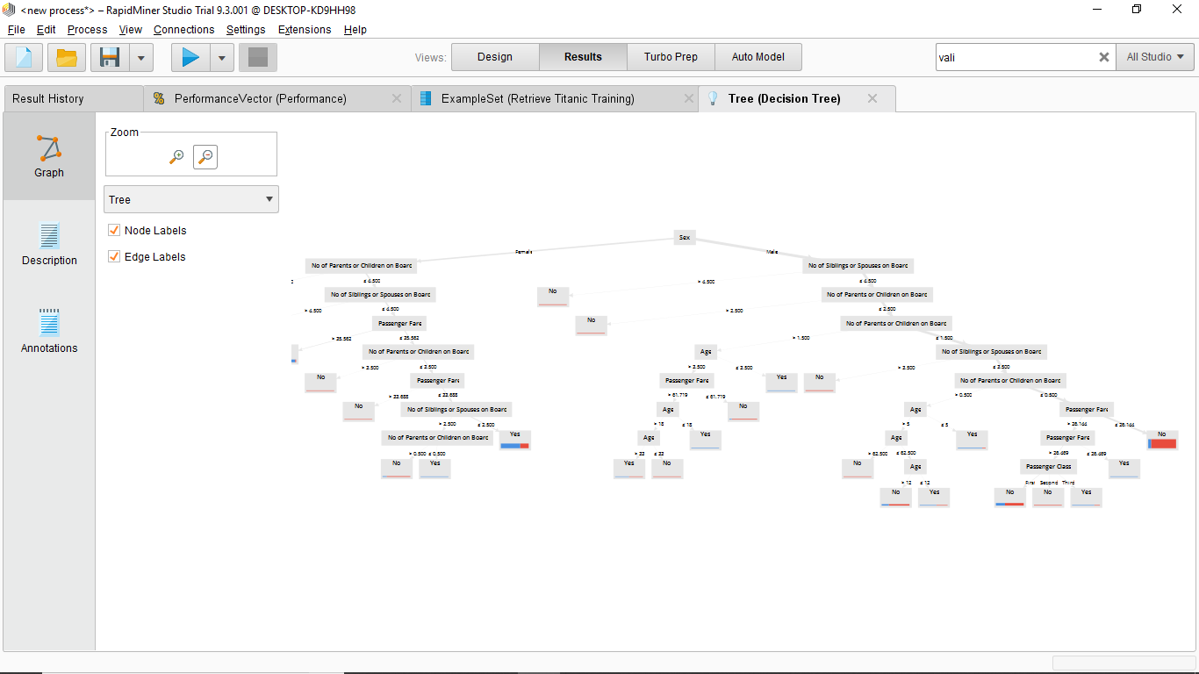
Data Mining Project Cont.

Slide 39
Web Mining
Web mining is the application of data mining techniques to discover patterns from the World Wide Web. As the name proposes, this is information gathered by mining the web.
The goal of Web structure mining is to generate structural summary about the Web site and Web page.

Slide 40
Web Mining Project
Question two: (Web Mining Technique)
Text mine from a social media account ( www.twitter.com)
By using www.trendmaps.com choose a trendy word in Egypt.

Slide 41
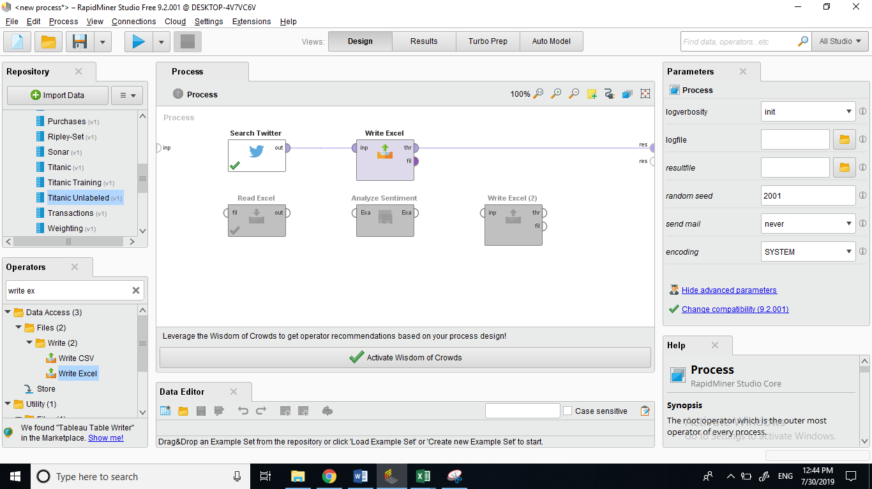
Web Mining Project Cont.

Slide 42
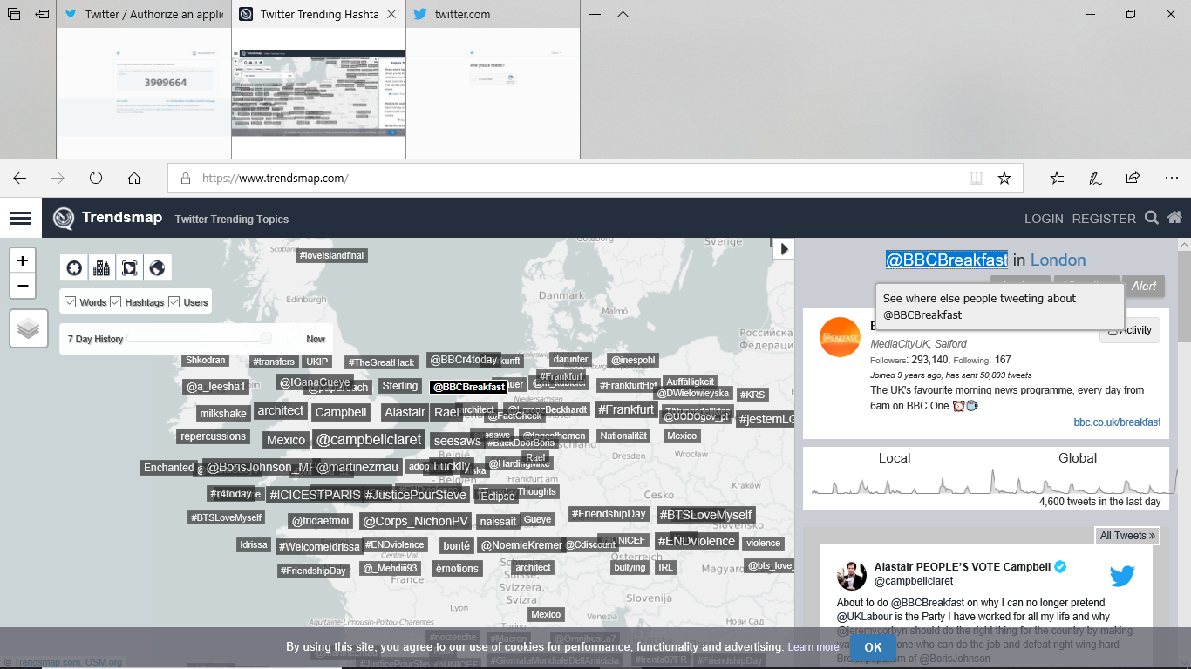
Web Mining Project Cont.

Slide 43
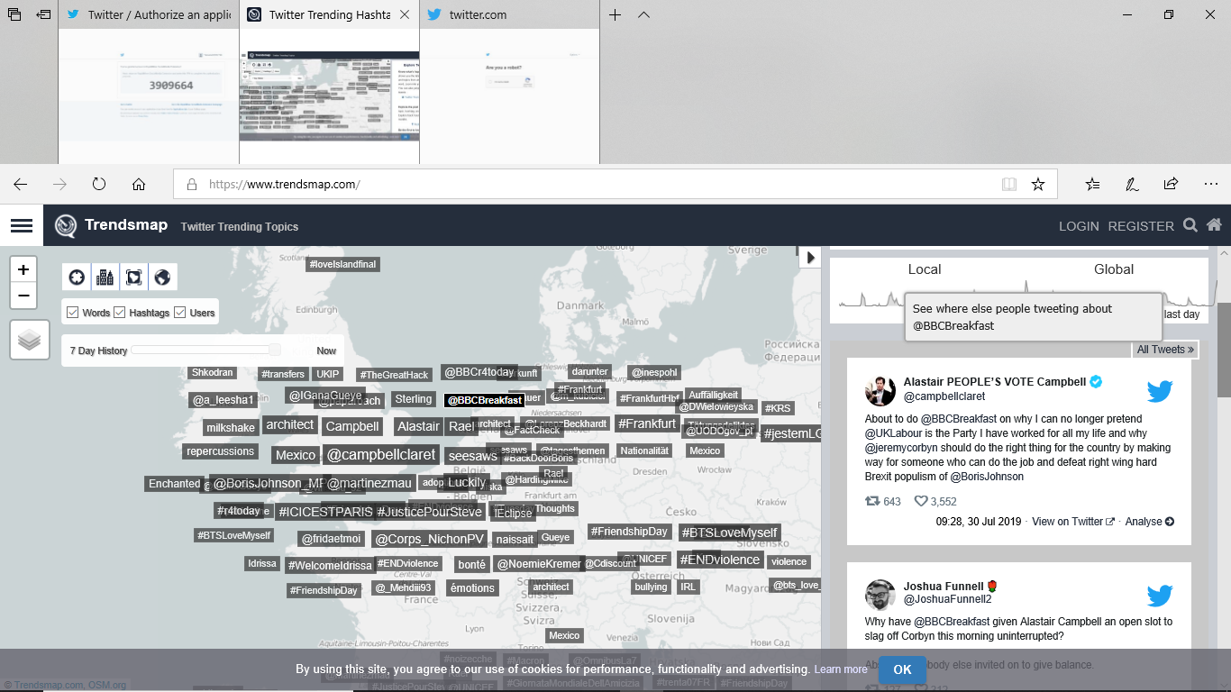
Web Mining Project Cont.

Slide 44
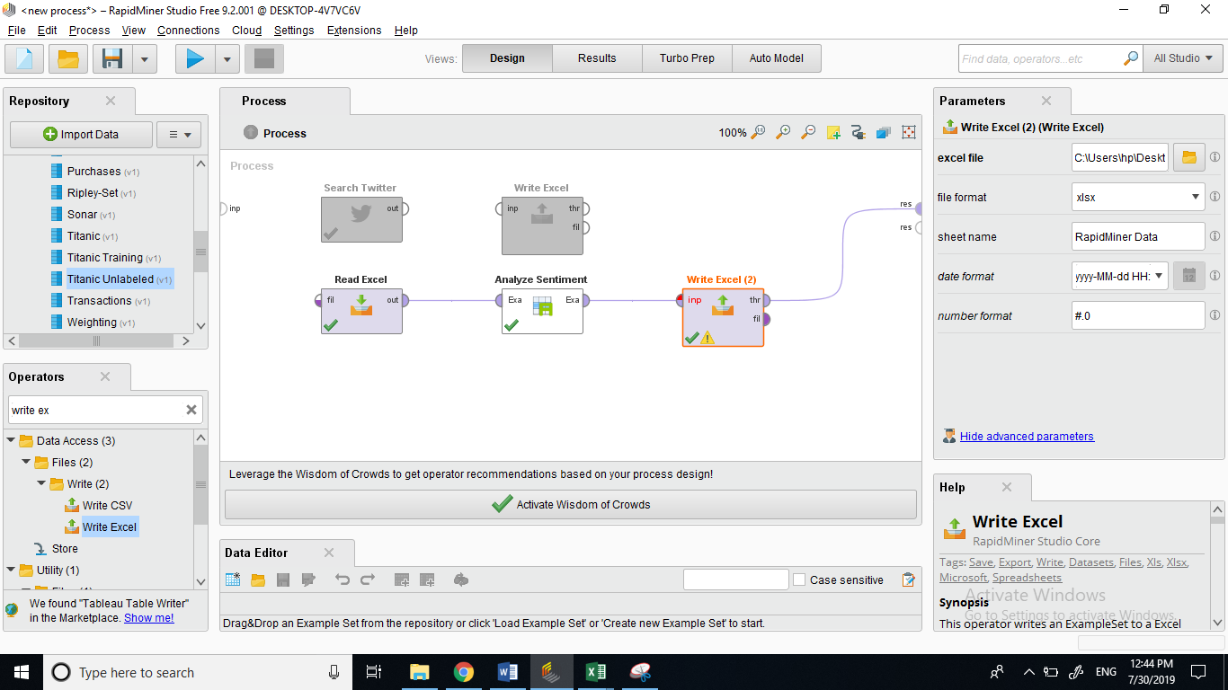
Web Mining Project Cont.

Slide 45
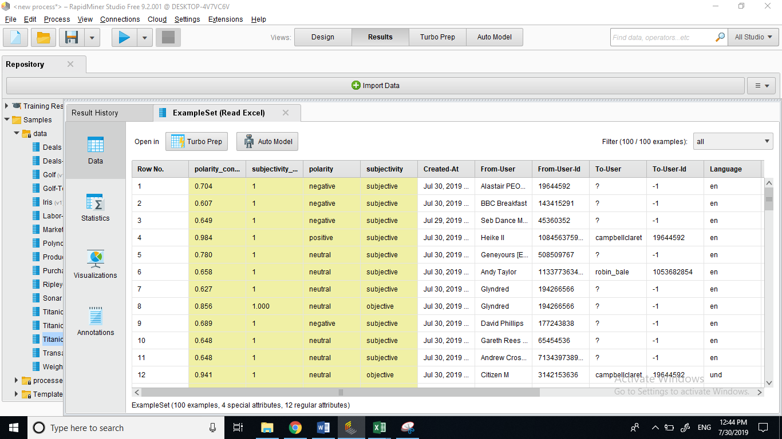
Web Mining Project Cont.

Slide 46
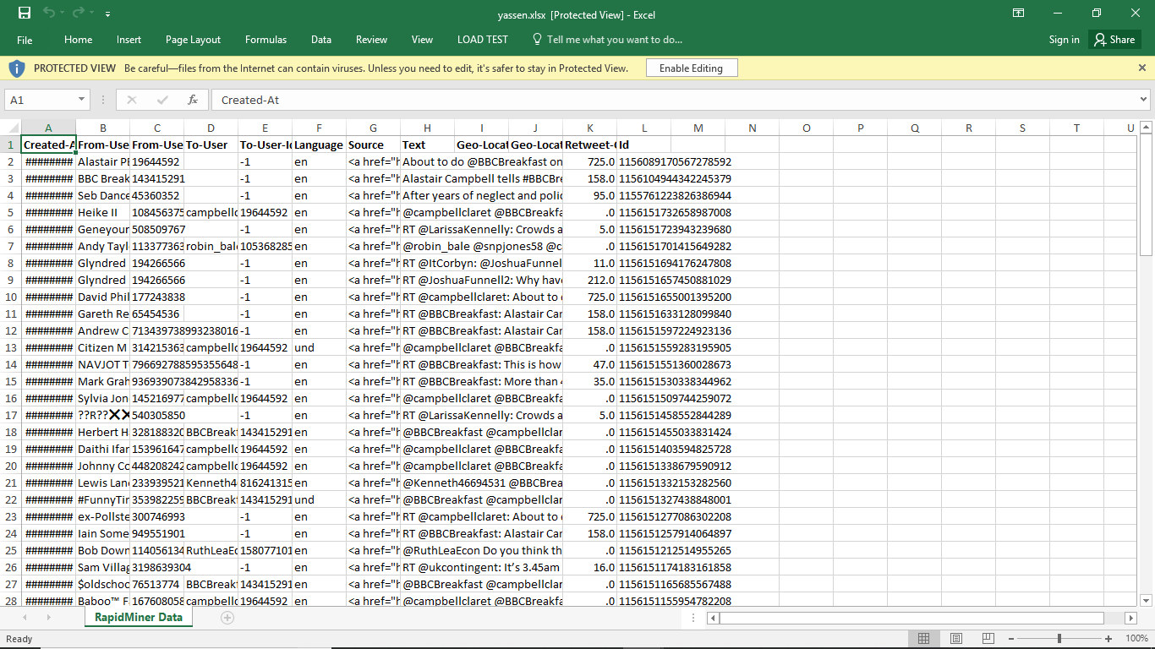
Web Mining Project Cont.

Slide 47
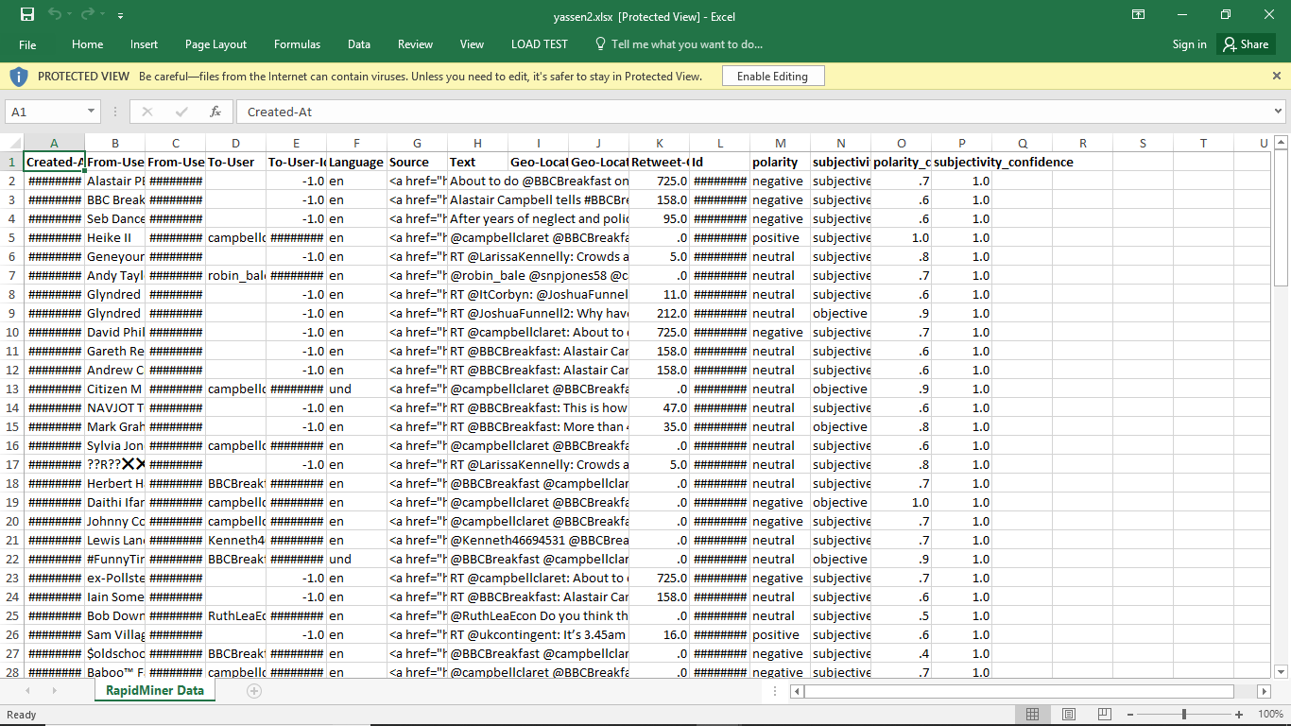
Web Mining Project Cont.

Slide 48
References
https://en.wikipedia.org/wiki/Decision_support_system 31 July 2019
https://en.wikipedia.org/wiki/Expert_system-31 July 2019
https://www.analyticsvidhya.com/blog/2017/02/lintroductory-guide-on-linear-programming-explained-in-simple-english/-31 July 2019
https://www.sas.com/en_us/insights/analytics/data-mining.html-1 August 2019
https://en.wikipedia.org/wiki/Web_mining-1 August 2019

Slide 49


