Slide 1

Siemens Keeps Knowledge Management Blooming with ShareNet
Presented BY: Yassen adel Mohamed
Reg. no: 15102520
Presented to: prof. dr. osama badawy

Slide 2
Contents:
Introduction
Setting Stages
Case Description
Problems Facing the Organization
Appendix
References

Slide 3
Introduction
Siemens, headquartered in Munich, is a German-based multinational corporation with a balanced business portfolio of activities predominantly in the field of electronics and electrical engineering. With sales of EUR 74.2 billion and a net income of EUR 2.4 billion in fiscal 2003, it was Europe’s industry leader with strong positions in the North American and Asian markets (in August 2003, EUR 1.00 was equivalent to about USD 1.13).
Approximately 50,000 researchers and developers were employed; research and development (R&D) investments totaled EUR 5.1 billion. Exhibit 1 shows Siemens’ financial performance from 2000 to 2003. Siemens was a conglomerate of six business segments: Information and Communications, Automation and Control, Power, Transportation, Medical, and Lighting. Each business segment was split into several groups with independent profit responsibility and regional sales organizations (local companies) around the globe.

Slide 4
Setting Stages
ShareNet, a global knowledge sharing network initially developed for the global Siemens sales and marketing community, was conceived in 1998. With the market environment in constant flux, Siemens realized it had to be able to provide flexible bundles of services and products that could be easily adapted to individual customers. To this end, the company recognized that a major improvement in the fast and purposeful identification and exchange of relevant information and knowledge was needed. Hence, Siemens ICN started the development of a community-based KMS under the name ShareNet. For “explicit knowledge,” the aim was to provide structured knowledge objects in the form of project descriptions, functional and technical solutions, customers, competitors, and markets. For “tacit knowledge,” the system was intended to provide functionalities such as newsgroups, discussion forums, and chats.

Slide 5
Case Description
The initial development of ShareNet started in 1998. ShareNet’s first key project stage — “definition and prototyping” — lasted from August 1998 to the end of March 1999. Objectives were to establish the ShareNet project team, to create conceptual definitions and refinements, to start prototyping the technical platform, and to ensure early executive and user buy-in. Soon, the ShareNet project team developed the vision of a structured KM initiative for the sales and marketing function: “ICN ShareNet is the global knowledge sharing network. We leverage our local innovations globally. We are a community committed to increase value for our customers and ICN by creating and reapplying leading-edge solutions.” The aim was to change Siemens ICN’s communication flow from a broadcast-oriented “enabling” approach that is, headquarters to local companies, to a meshed network approach required for fast global learning.

Slide 6
Problems Facing the Organization
The collapse of the telecommunications sector in 2001 did hurt Siemens ICN as seriously as any of its competitors. As a response, the group executive management started the Profit and Cash Turnaround (PACT) program. Its first phase, “clean-up,” aimed for cost reductions through organizational redesign, headcount reduction, and improved asset management. This phase lasted until fiscal 2003. In the same year, the overlapping second phase, “rebuild,” started — continuing until 2004. It comprised customer-orientated portfolio adjustments, as well as the implementation of innovative concepts for leveraging the synergies of enterprise and carrier solutions. Beginning in fiscal 2004, the third phase, “growth,” emphasized intense customer relationships, streamlined processes, and a balanced portfolio of products and services.

Slide 7
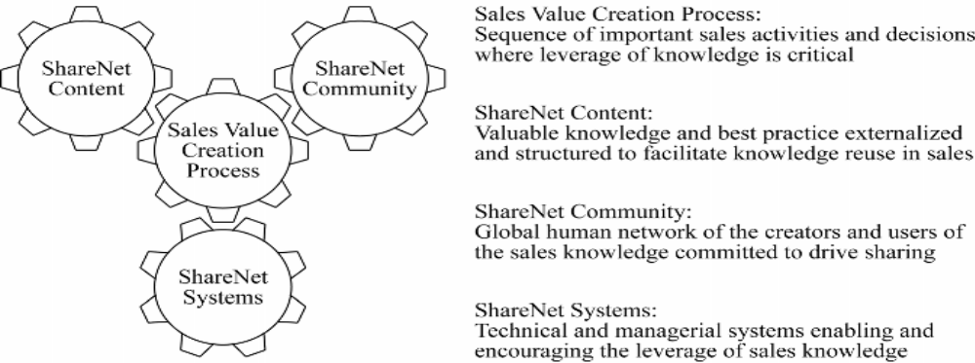
Appendix
ShareNet as an Interplay of Four Crucial Elements

Slide 8
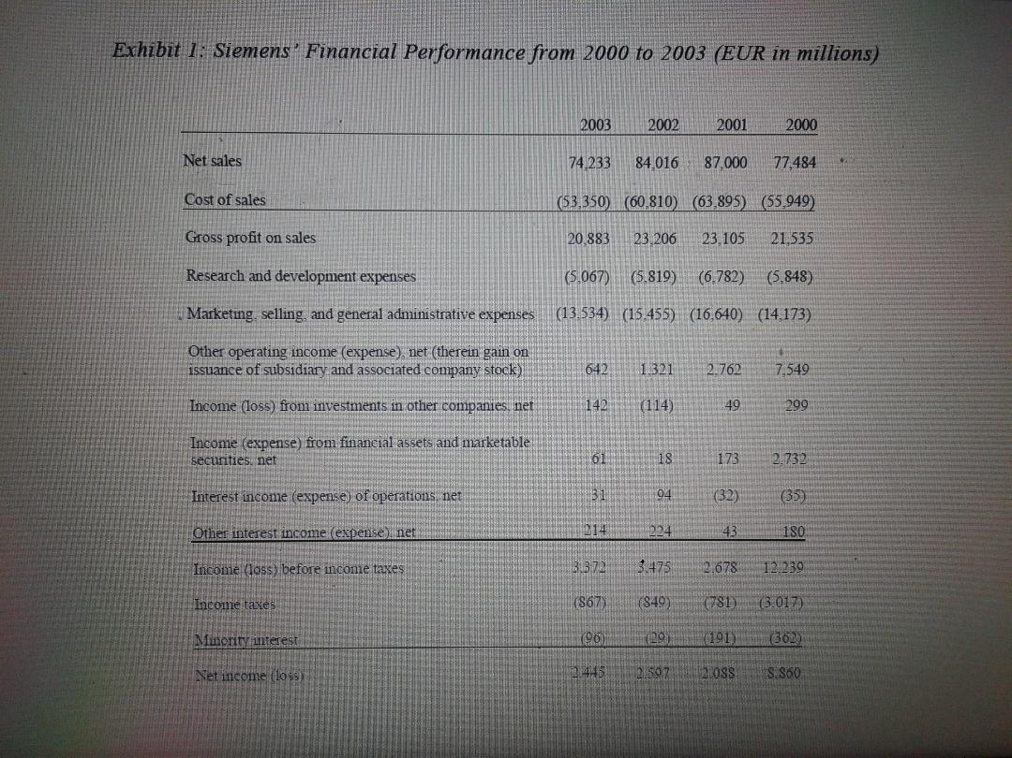
Appendix Cont.

Slide 9
References
Alavi, M., & Leidner, D.E. (2001). Knowledge management and knowledge management systems: Conceptual foundations and research issues. MIS Quarterly, 25(1), 107-136.
Davenport, T.H., De Long, D.W., & Beers, M.C. (1998). Successful knowledge management projects. Sloan Management Review, 39(2), 43-57.
Earl, M.J. (2001). Knowledge management strategies: Toward a taxonomy. Journal of Management Information Systems, 18(1), 215-233.
Fahey, L., & Prusak, L. (1998). The eleven deadliest sins of knowledge management. California Management Review, 40(3), 265-276.
Gerndt, U. (2000). Serving the community. KM Magazine, 3(9), 7-10.
Gibbert, M., Kugler, P., & Völpel, S. (2002). Getting real about knowledge sharing: The premium-on-top bonus system. In T.H. Davenport, & G.J.B. Probst (Eds.), Knowledge management case book: Siemens best practices (2nd ed., pp. 260-278).
Erlangen and New York: Publicis Corporate Publishing and John Wiley & Sons.

Slide 10


